Slide 1
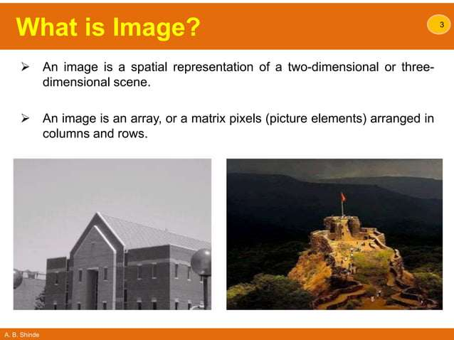

Slide 3
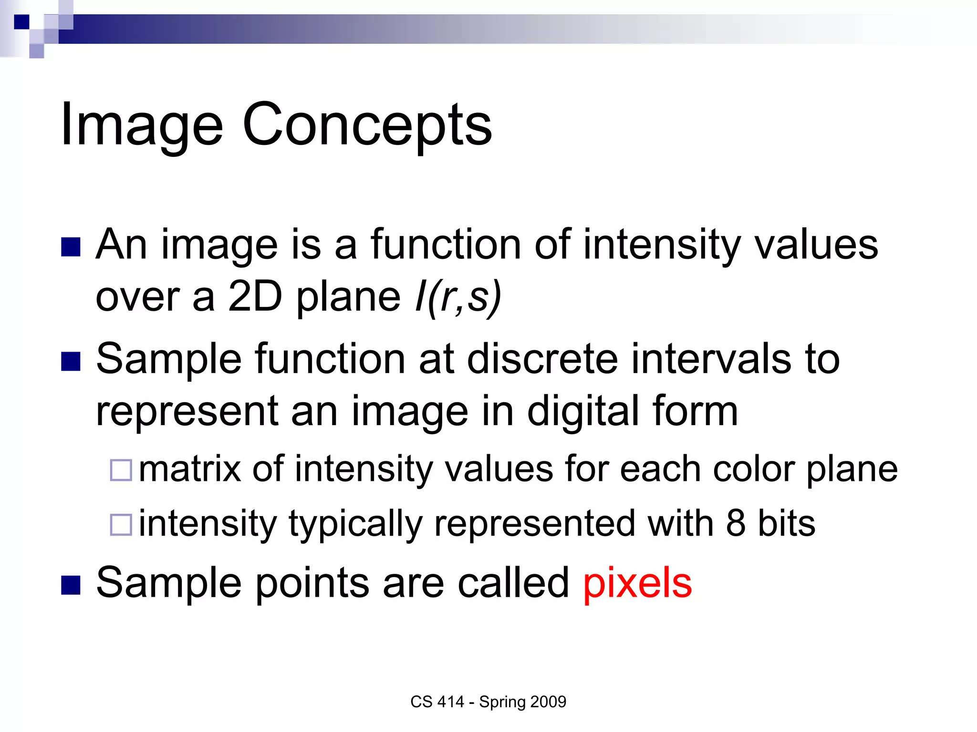

Slide 4
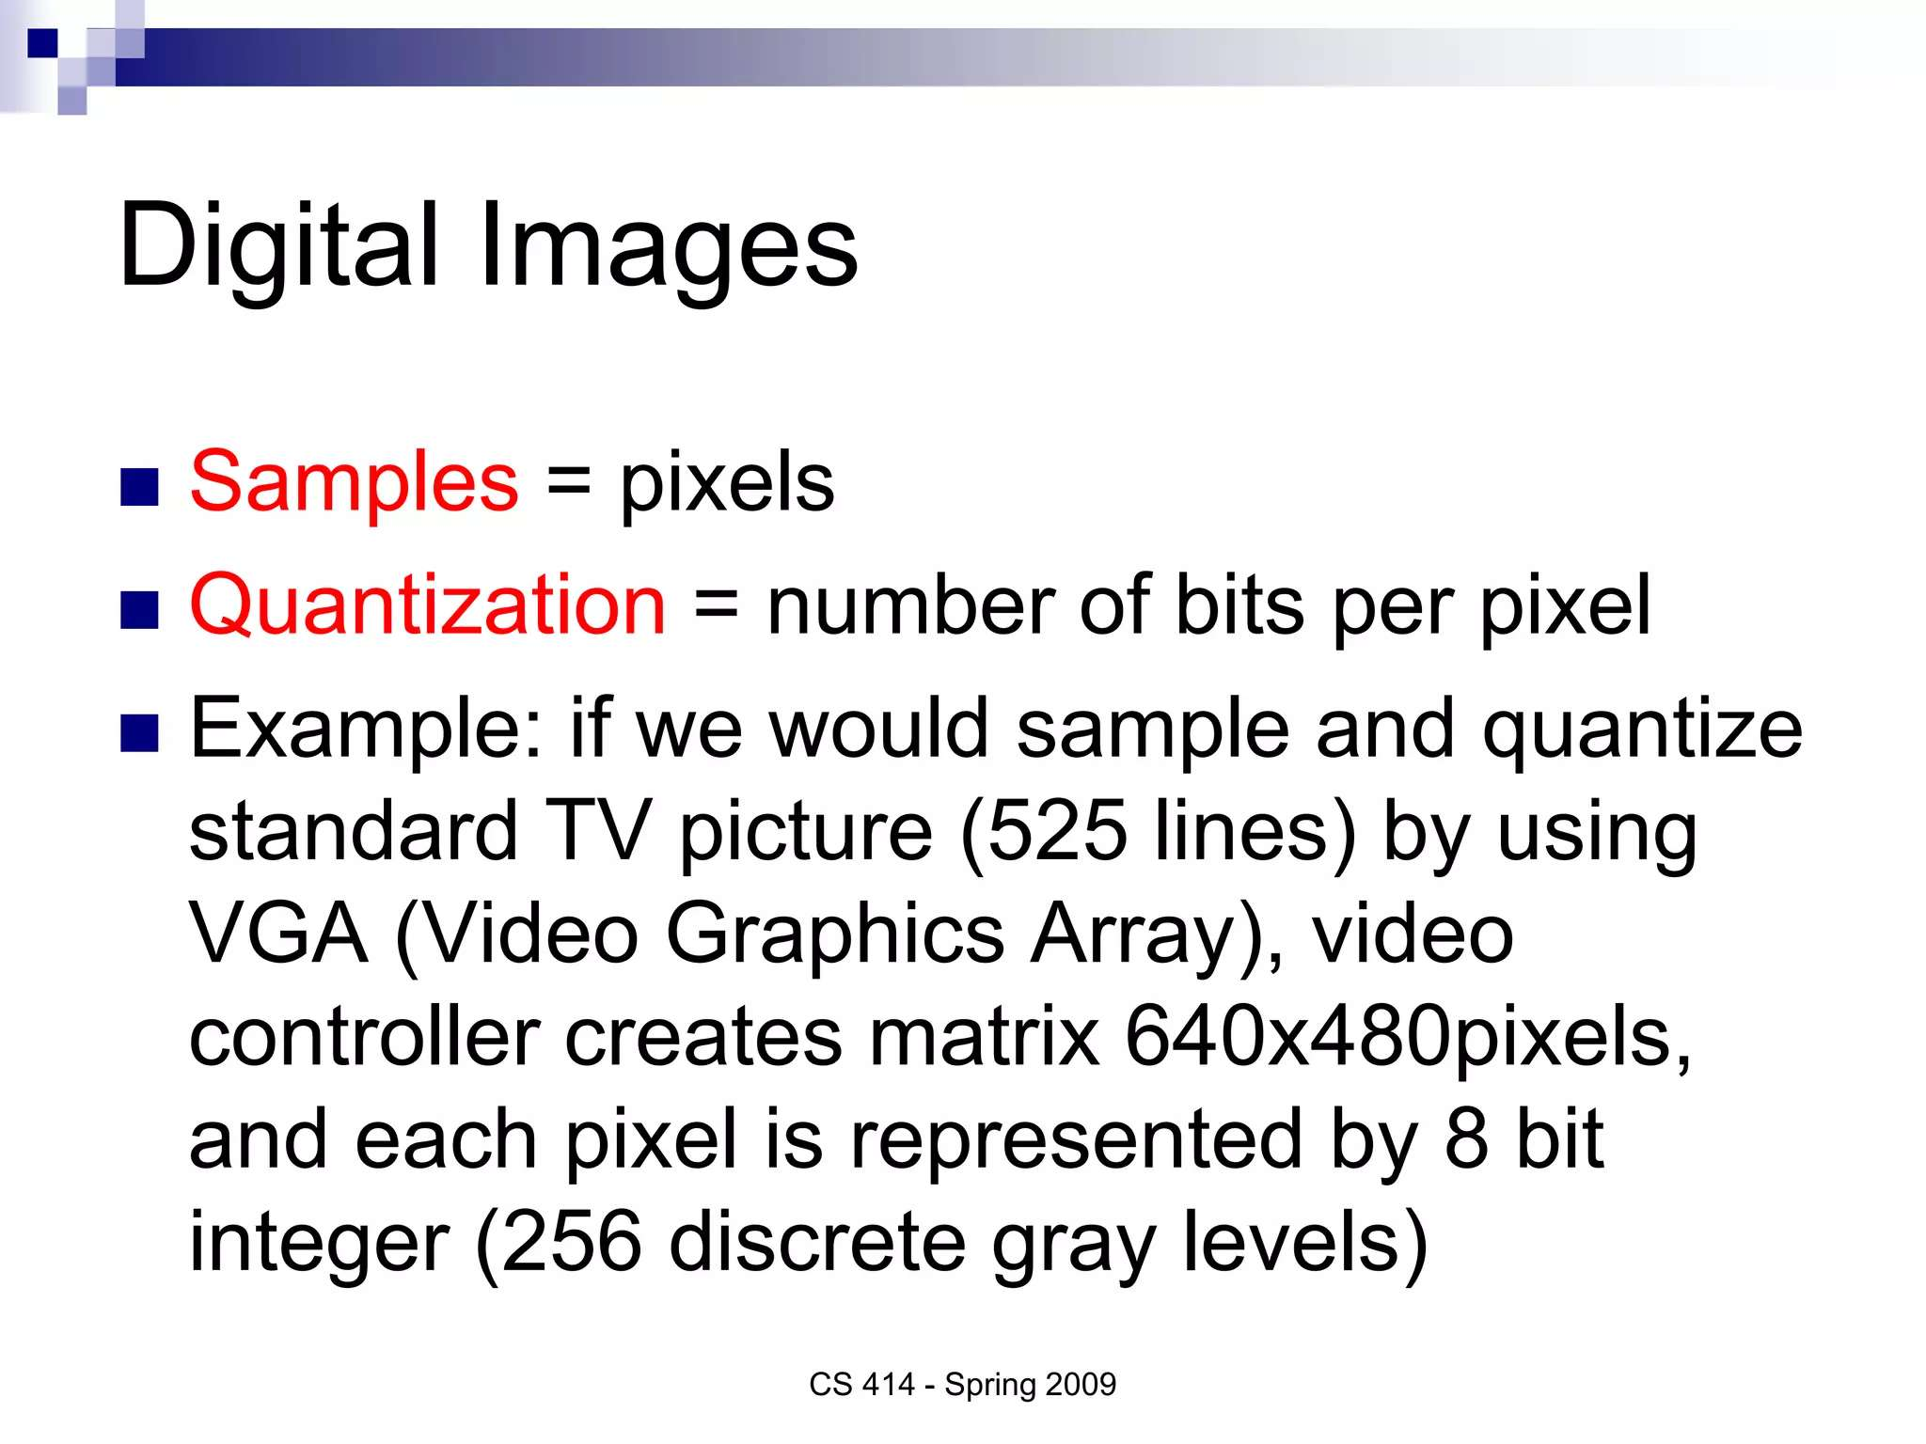

Slide 5
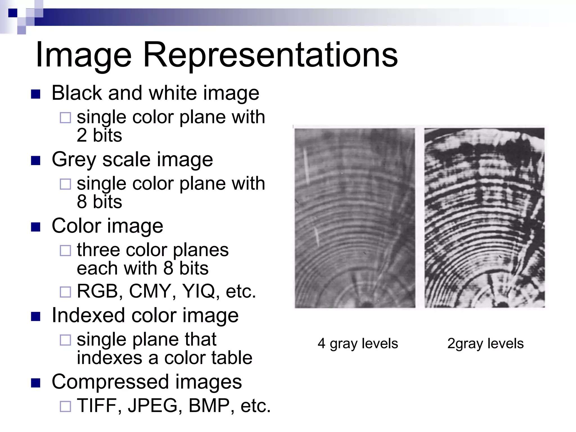

Slide 6
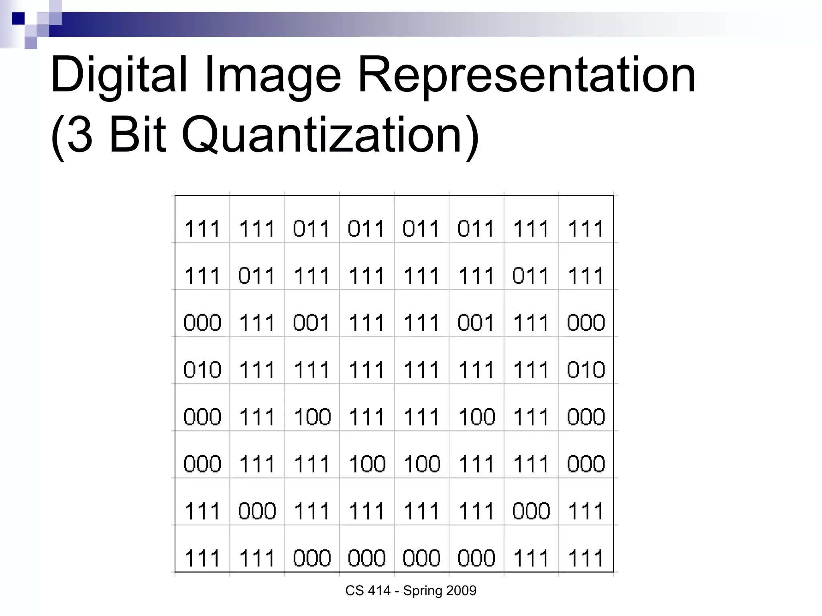

Slide 7
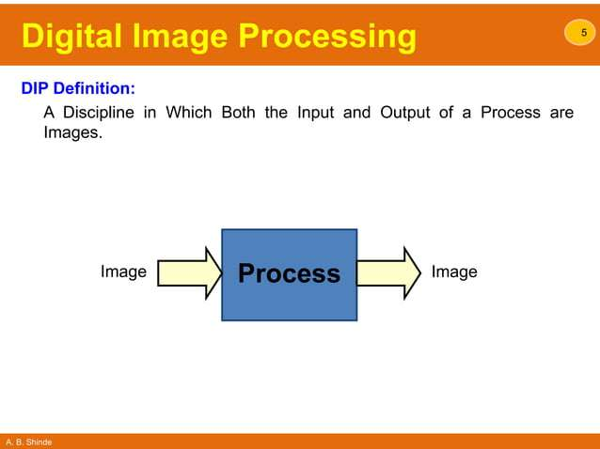

Slide 8
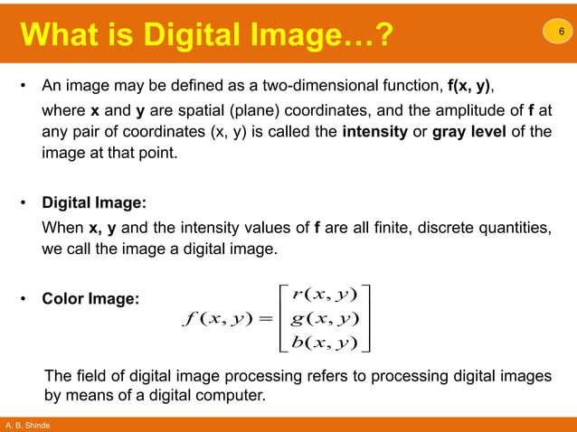

Slide 9
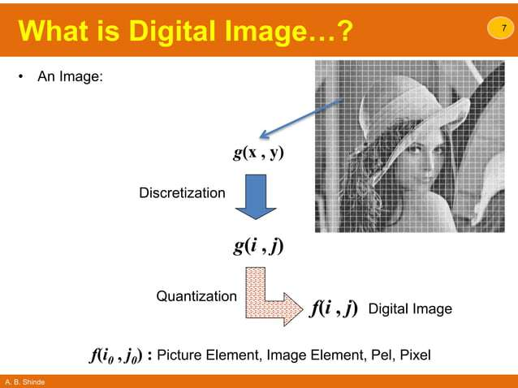

Slide 10
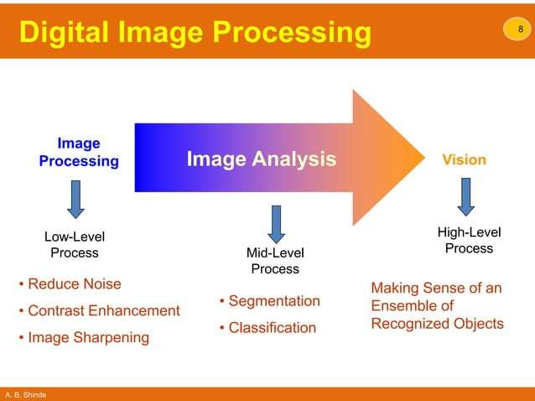

Slide 11
Pixel and Resolution
Pixel (Picture Element): A pixel is the smallest part of a computer picture. It shows one spot in the whole photo. Every little square has information about color, brightness and position. When these squares are put together with others they make a complete picture that we can see. Pixels are the parts that make up digital screens. They arrange together to show letters, pictures and videos.
Resolution: Resolution means the number of little squares, called pixels, in a digital photo. It's usually measured by width and height size. Using more details gives better results in pictures. Usual measurements for resolution are pixels per inch (PPI) for pictures that get printed and pixels per centimeter (PPCM). For example, a screen that can show pictures at 1920 x 1080 has more tiny dots or pixels from left to right and has 1920 pixels horizontally and 1080 pixels vertically.

Slide 12
JPEG, GIF, and PNG
JPEG: Joint Photographic Experts Group
GIF: Graphics Interchange Format
PNG: Portable Network Graphics
BMP (Bitmap)
TIFF (or TIF, for the file extension; Tagged Image File Format)

Slide 13
JPEG and PNG
JPEG
A common format for web images and Microsoft Office documents. JPEGs use "lossy" compression, which means that the image quality decreases as the file size decreases.
PNG
A format for photos and pictures that need a transparent background or animations. PNGs use "lossless" compression, which means that the image quality is the same before and after compression.

Slide 14
GIF
A format that can reduce the size of images and short animations. GIF is the only format that supports animation, making it suitable for ads, banners, and memes.

Slide 15
Light that is void of color is called monochromatic (or achromatic) light. The only attribute of monochromatic light is its intensity or amount. Because the intensity of monochromatic light is perceived to vary from black to grays and finally to white, the term gray level is used commonly to denote monochromatic intensity. We use the terms intensity and gray level interchangeably in subsequent discussions. The range of measured values of monochromatic light from black to white is usually called the gray scale, and monochromatic images are frequently referred to as gray-scale images.

Slide 16
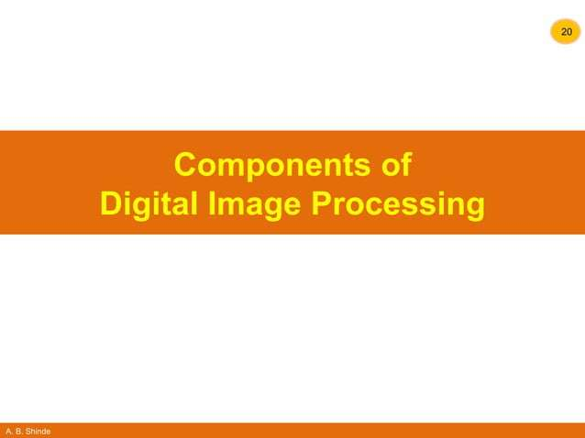

Slide 17
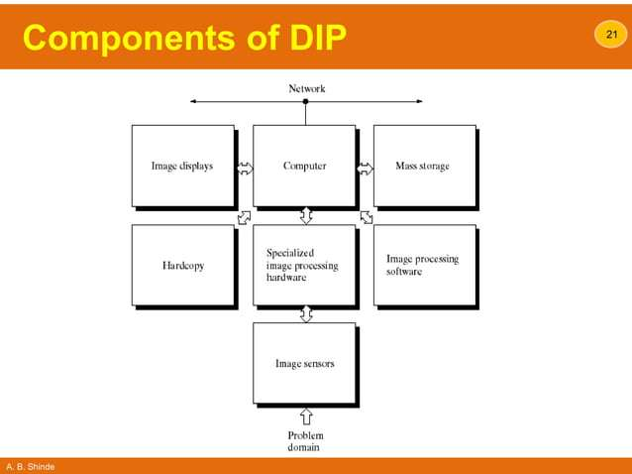

Slide 18
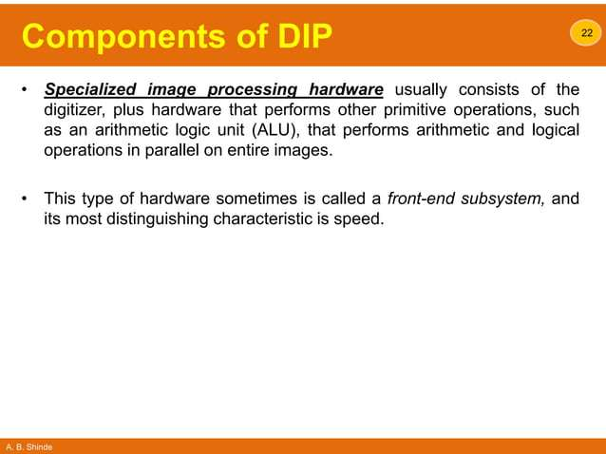

Slide 19
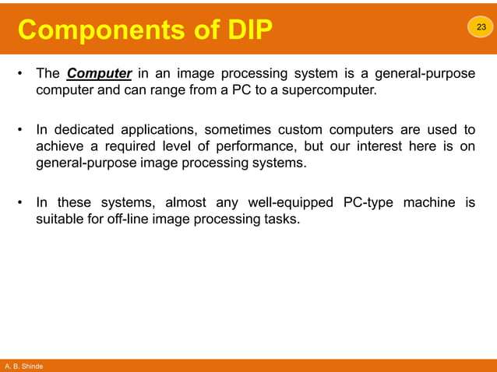

Slide 20


Slide 21
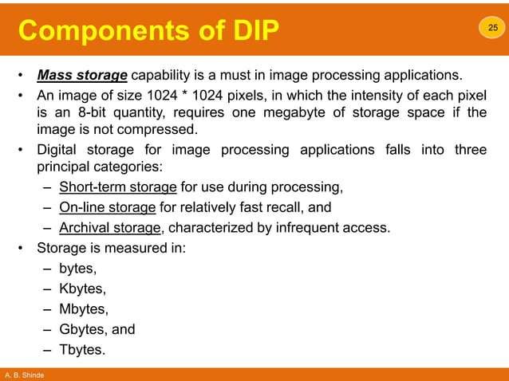

Slide 22
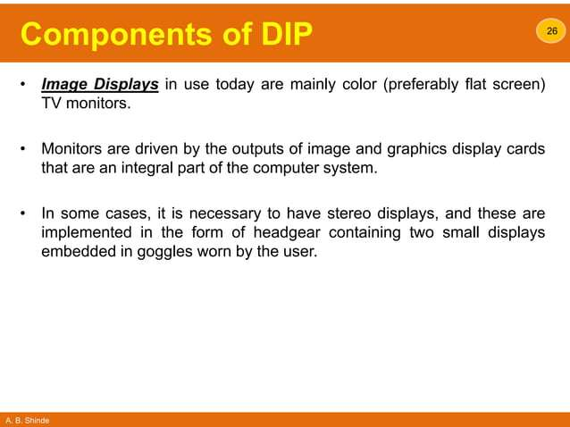

Slide 23
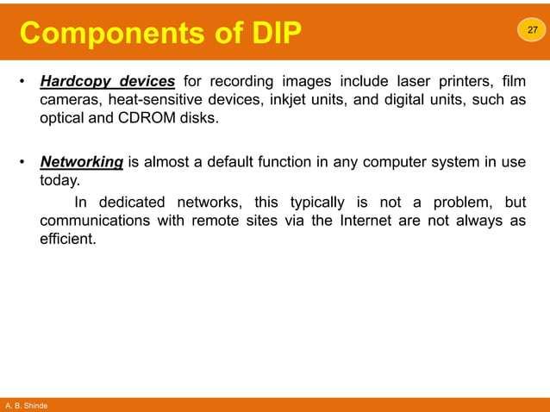

Slide 24


Slide 25
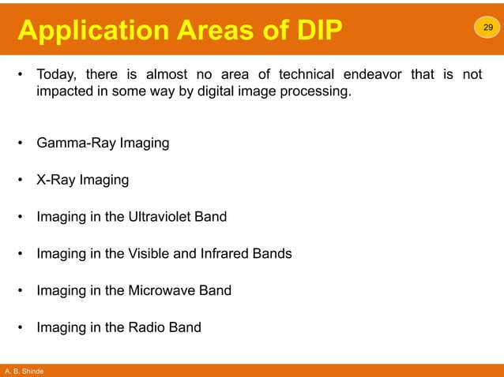

Slide 26
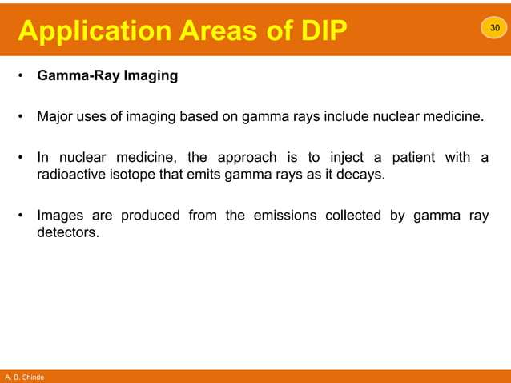

Slide 27
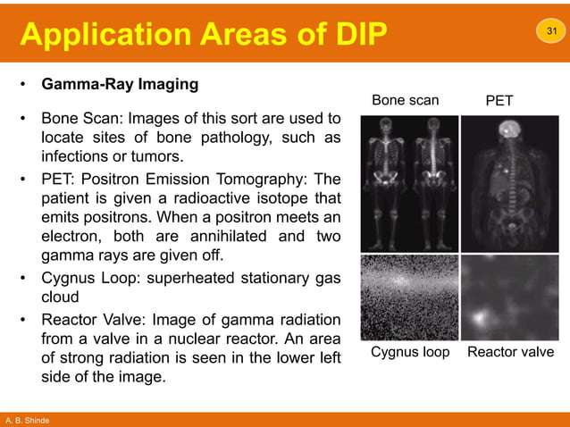

Slide 28
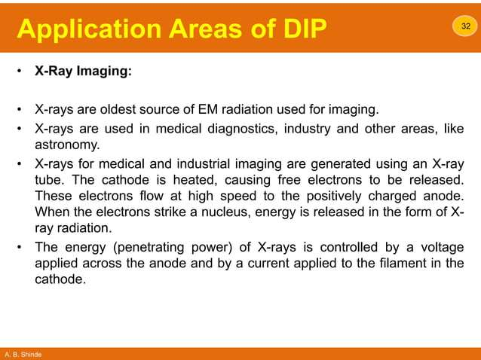

Slide 29
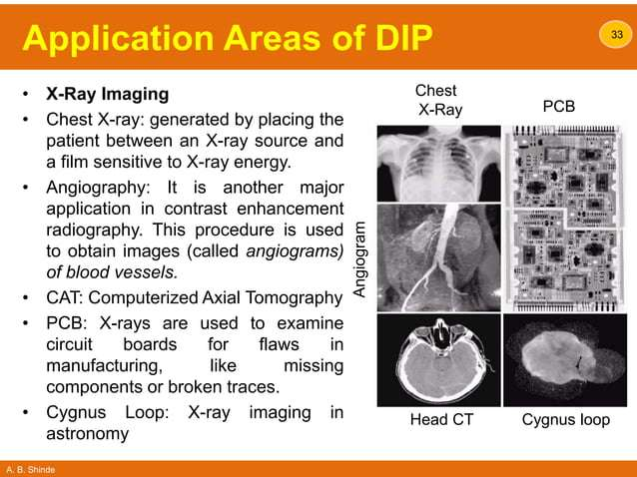

Slide 30
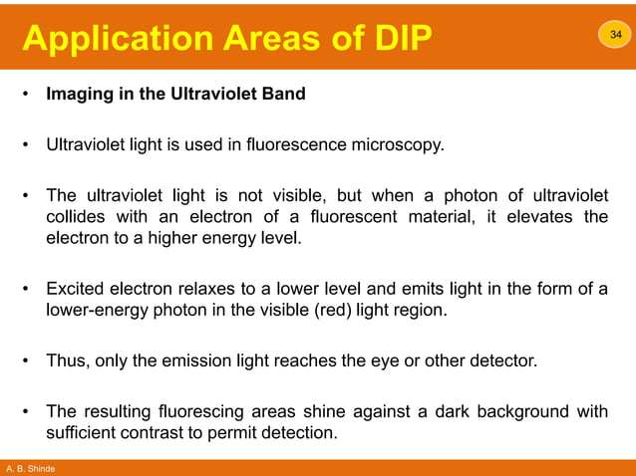

Slide 31
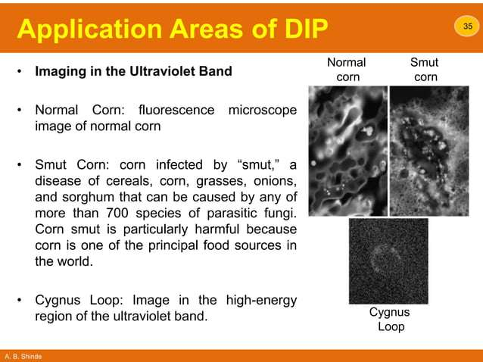

Slide 32
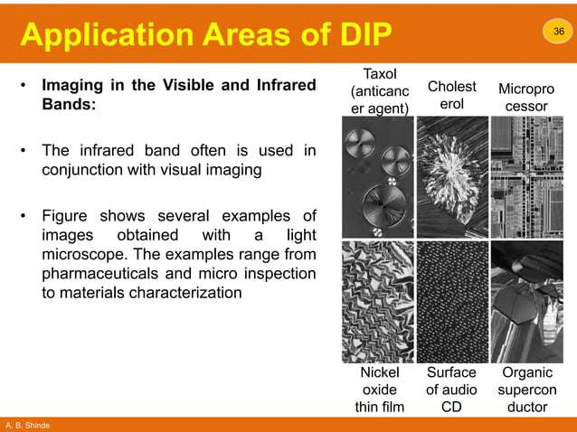

Slide 33
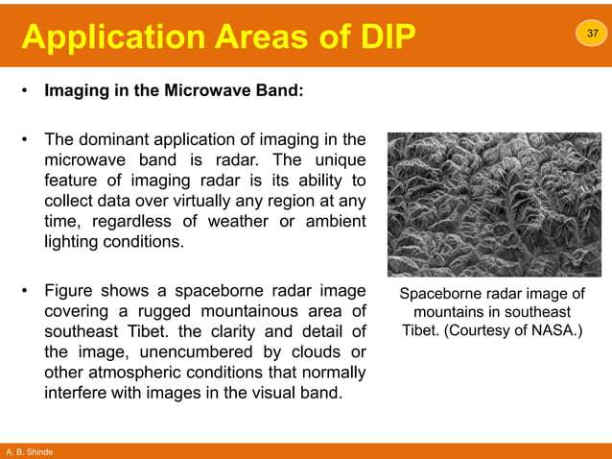

Slide 34
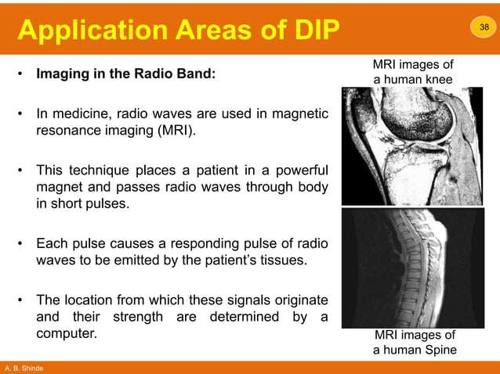

Slide 35


Slide 36


Slide 37


Slide 38


Slide 39


Slide 40


Slide 41


Slide 42
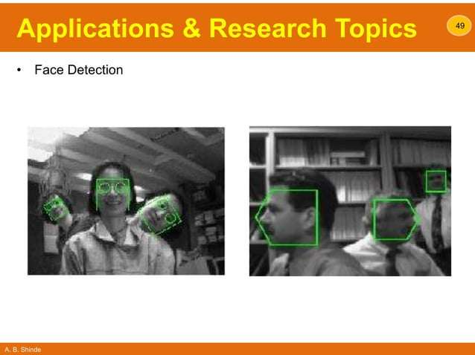

Slide 43
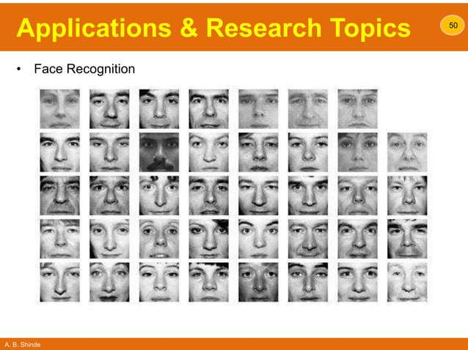

Slide 44
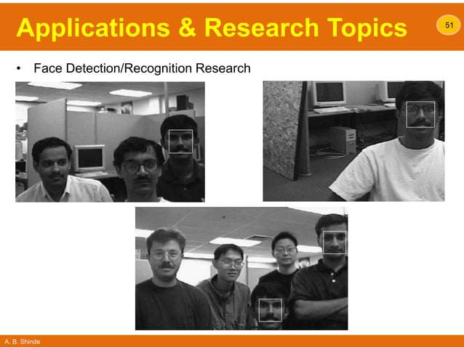

Slide 45
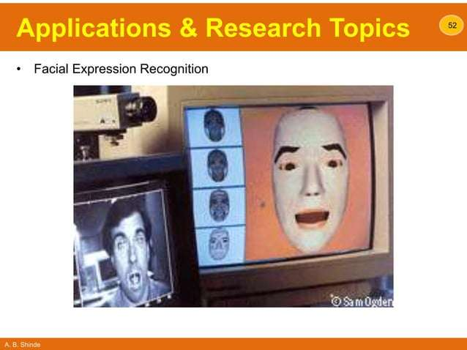

Slide 46


Slide 47


Slide 48
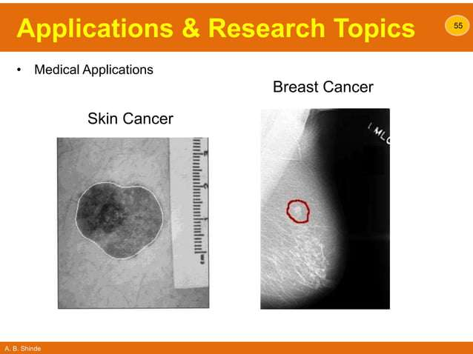

Slide 49
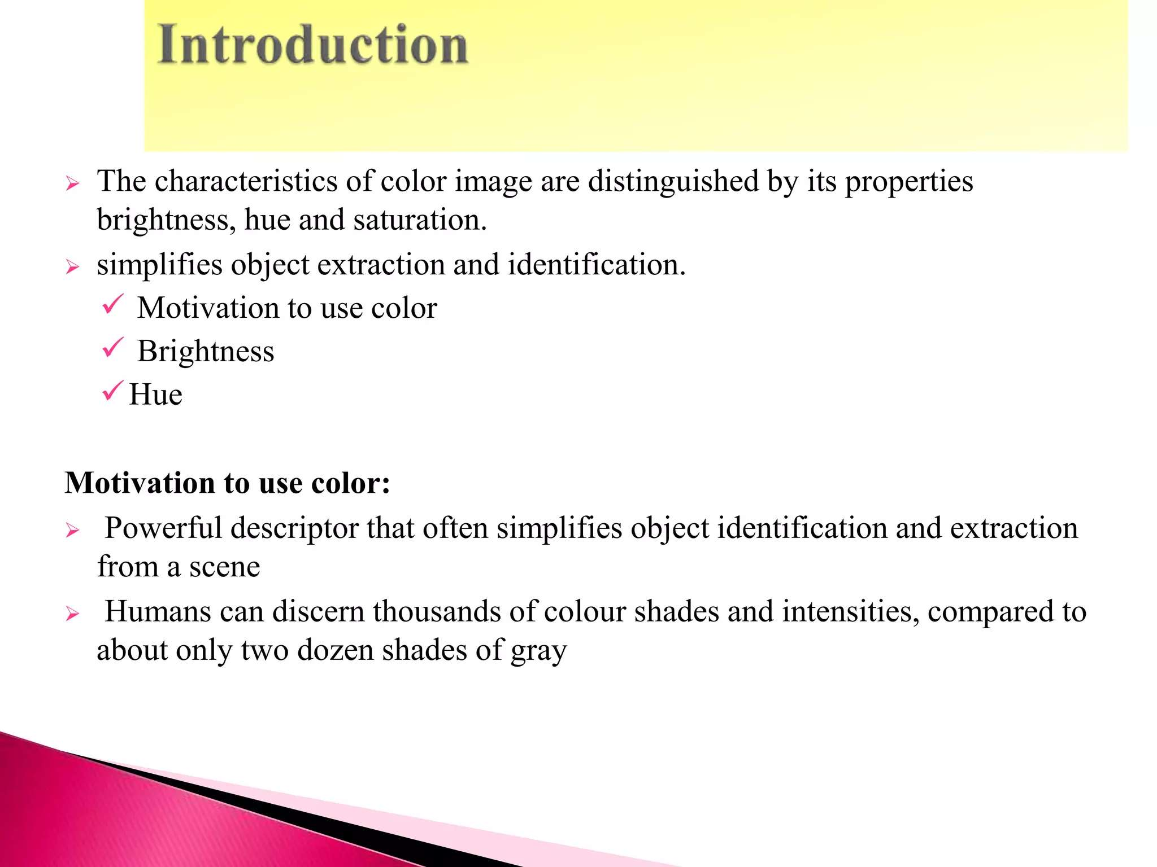

Slide 50
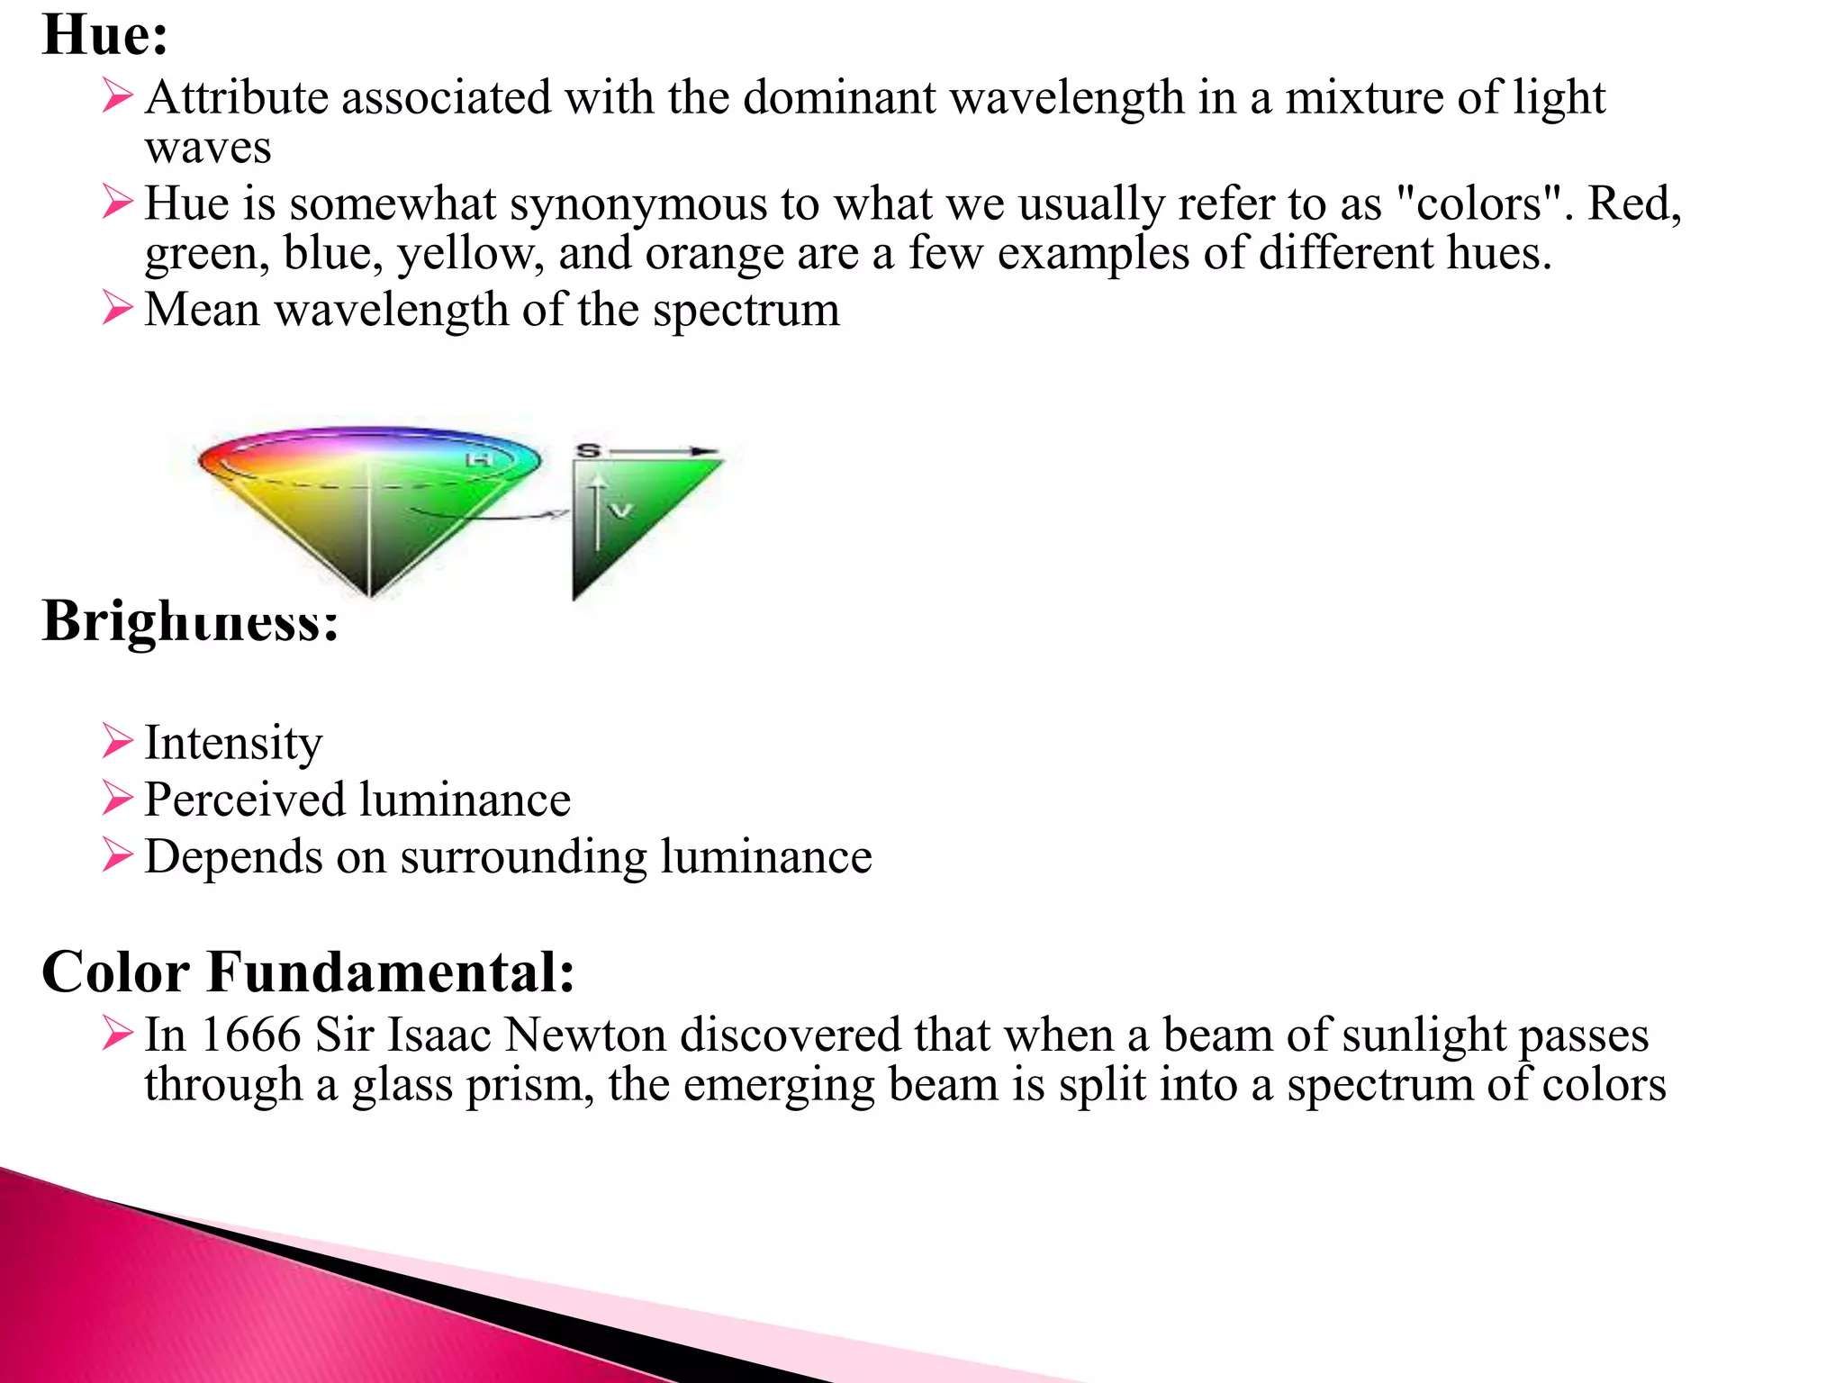

Slide 51
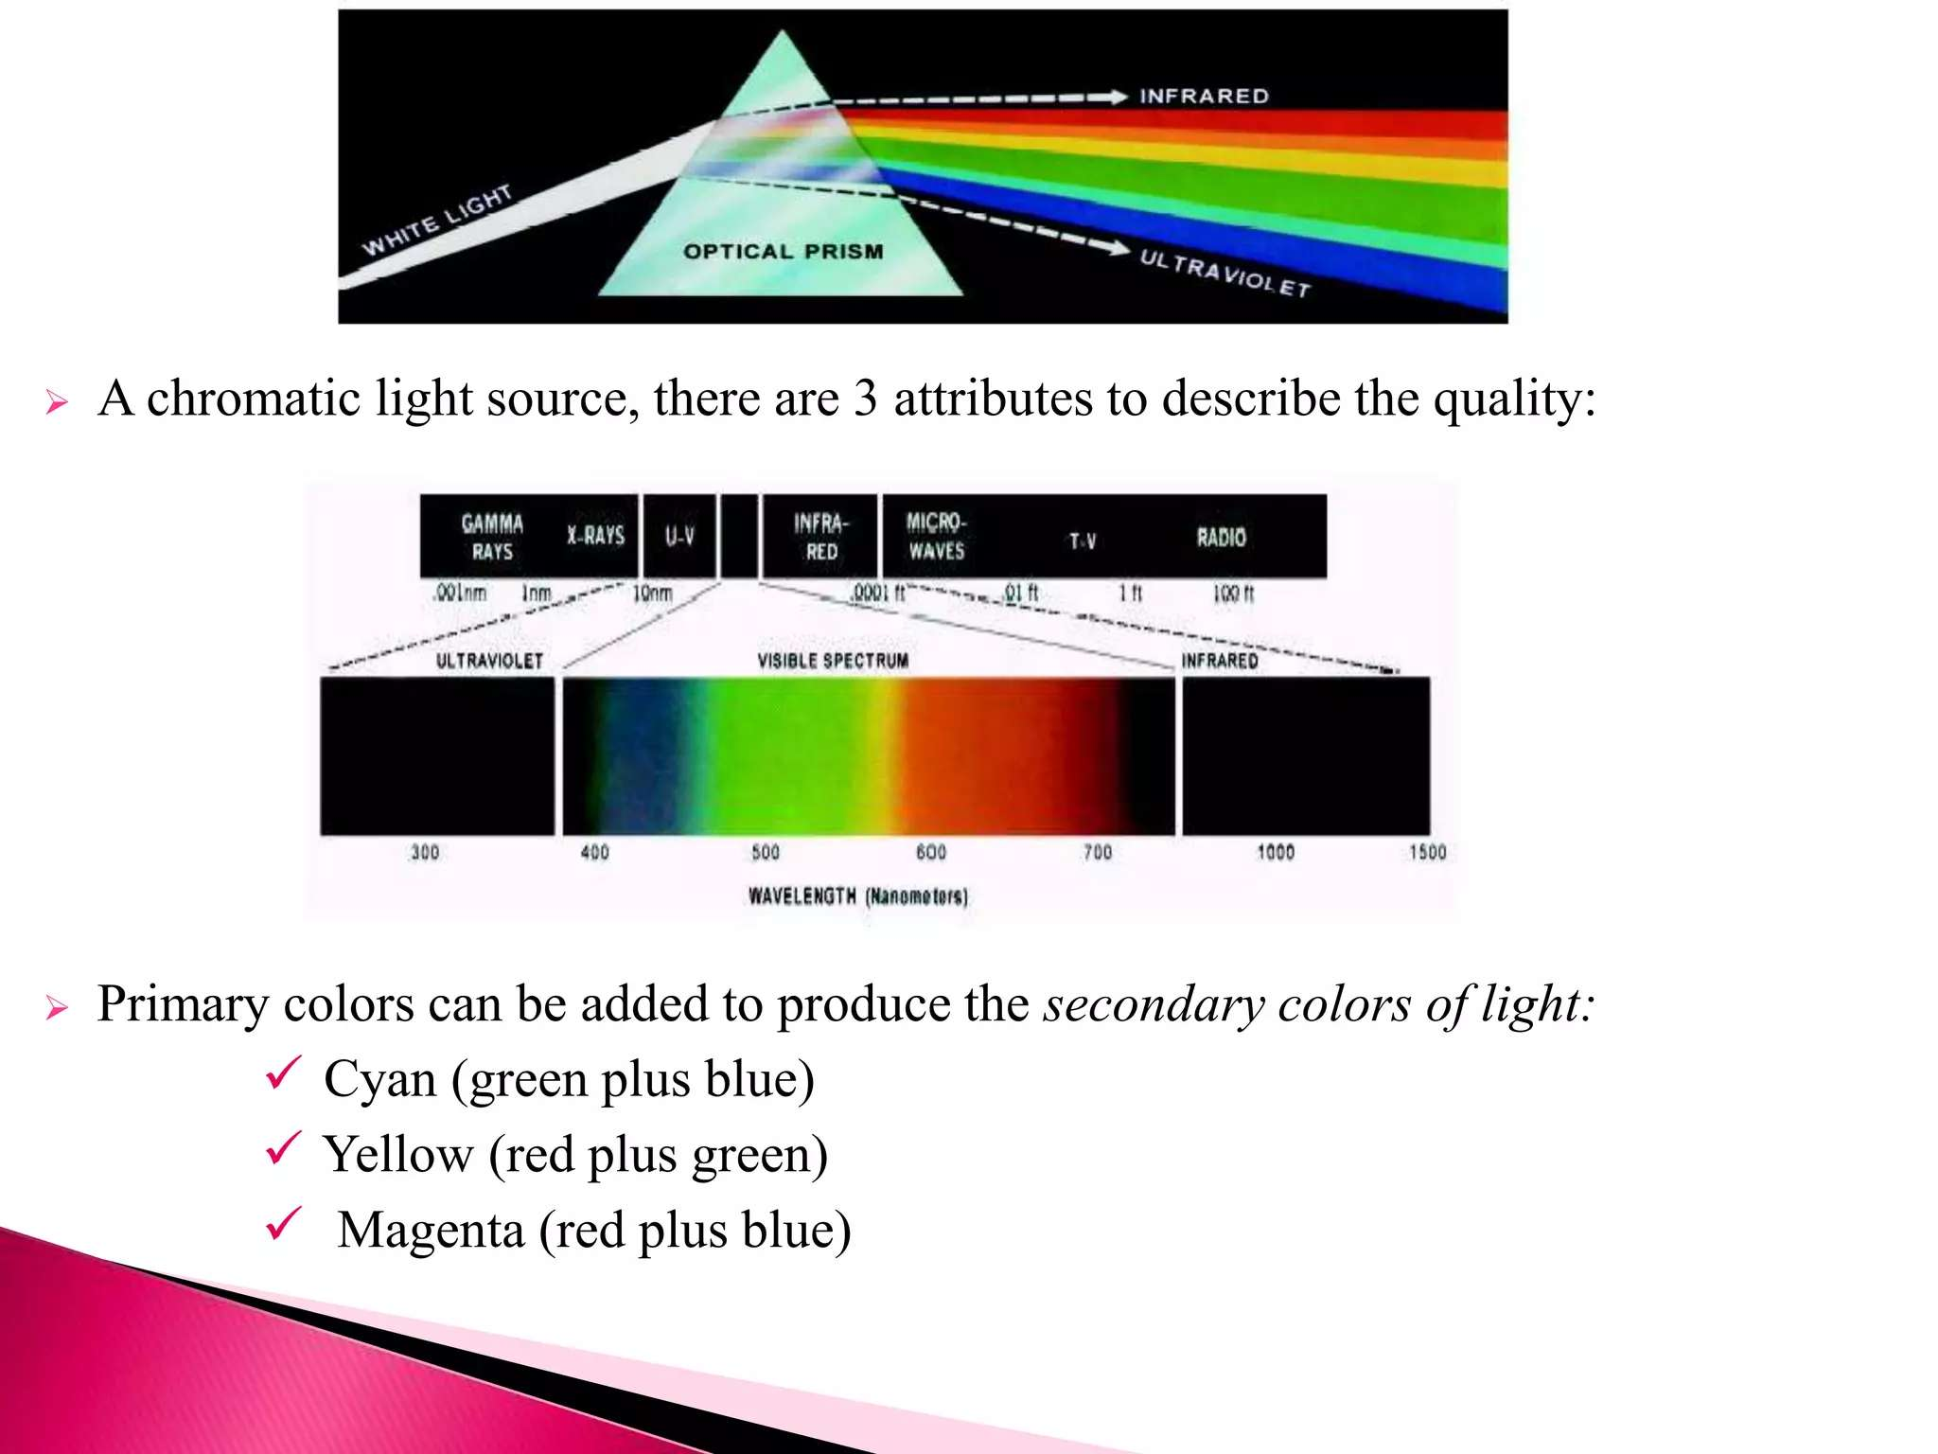

Slide 52
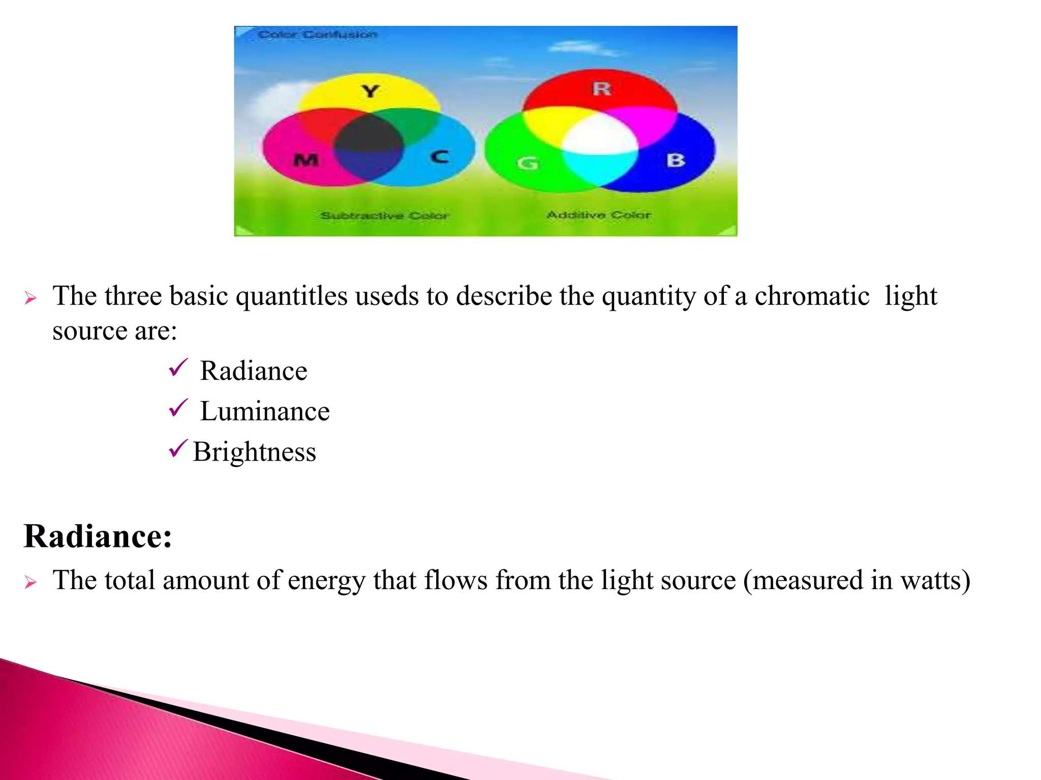

Slide 53
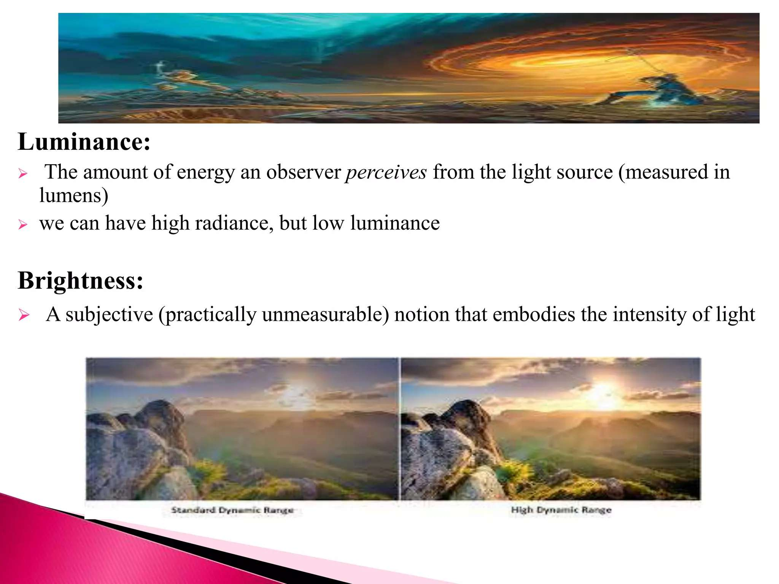

Slide 54
Brightness
Brightness is a subjective descriptor of light perception that is practically impossible to measure. It embodies the achromatic notion of intensity and is one of the key factors in describing color sensation.

Slide 55
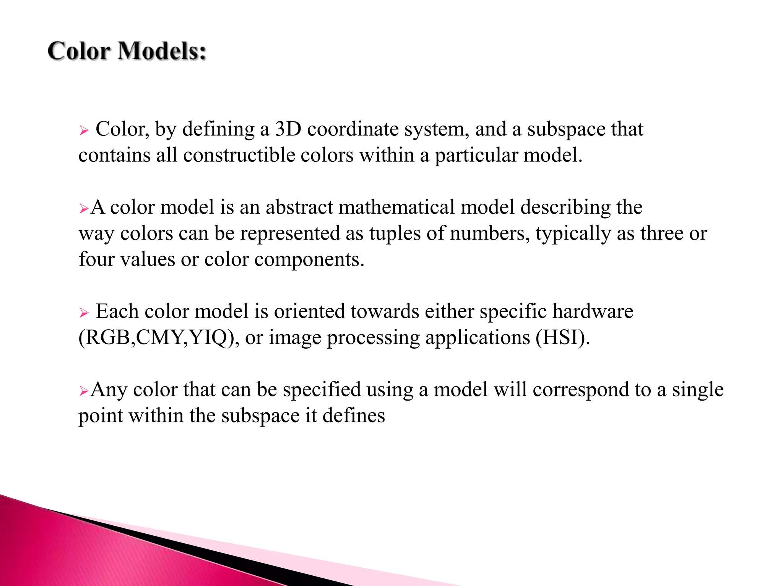

Slide 56
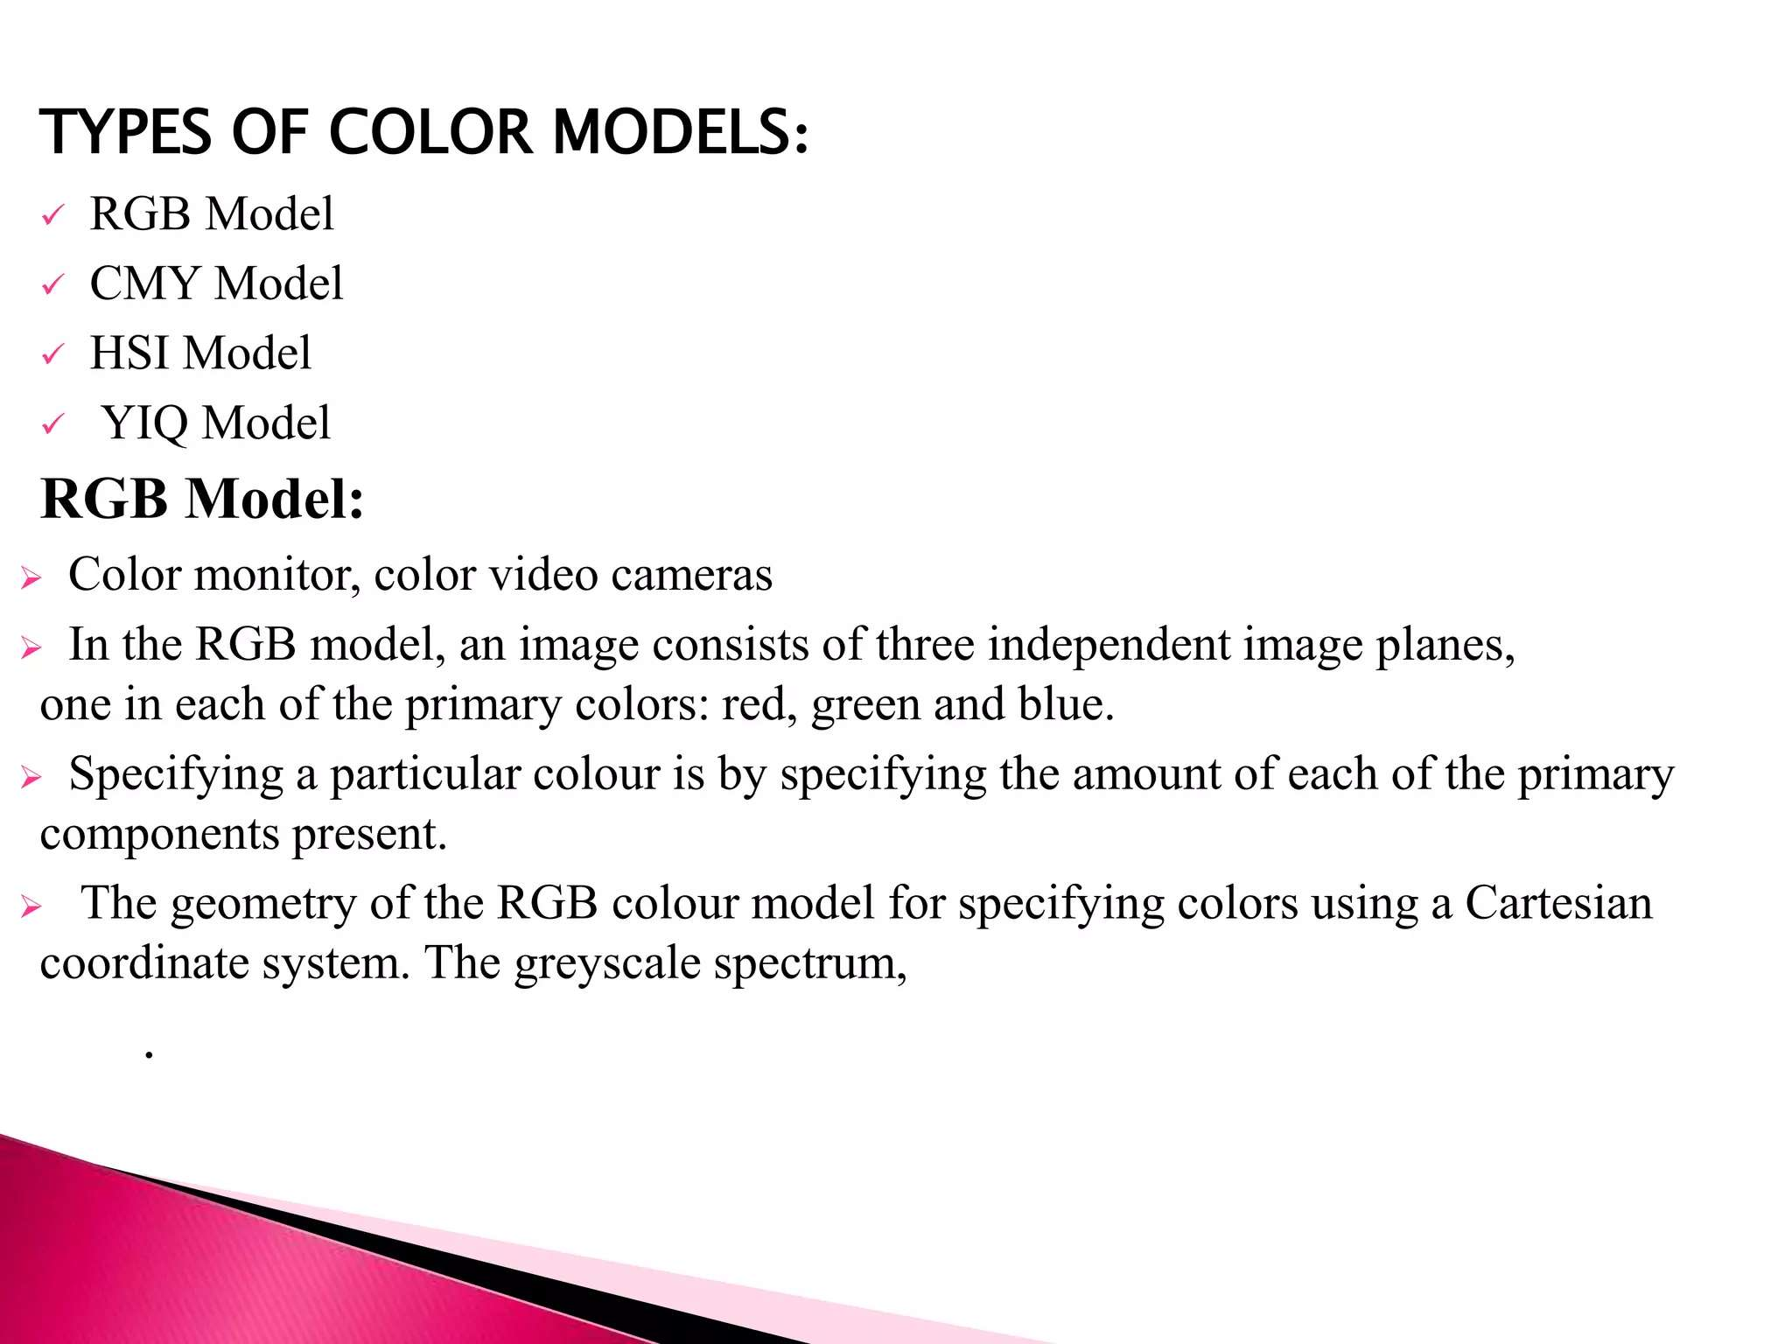

Slide 57
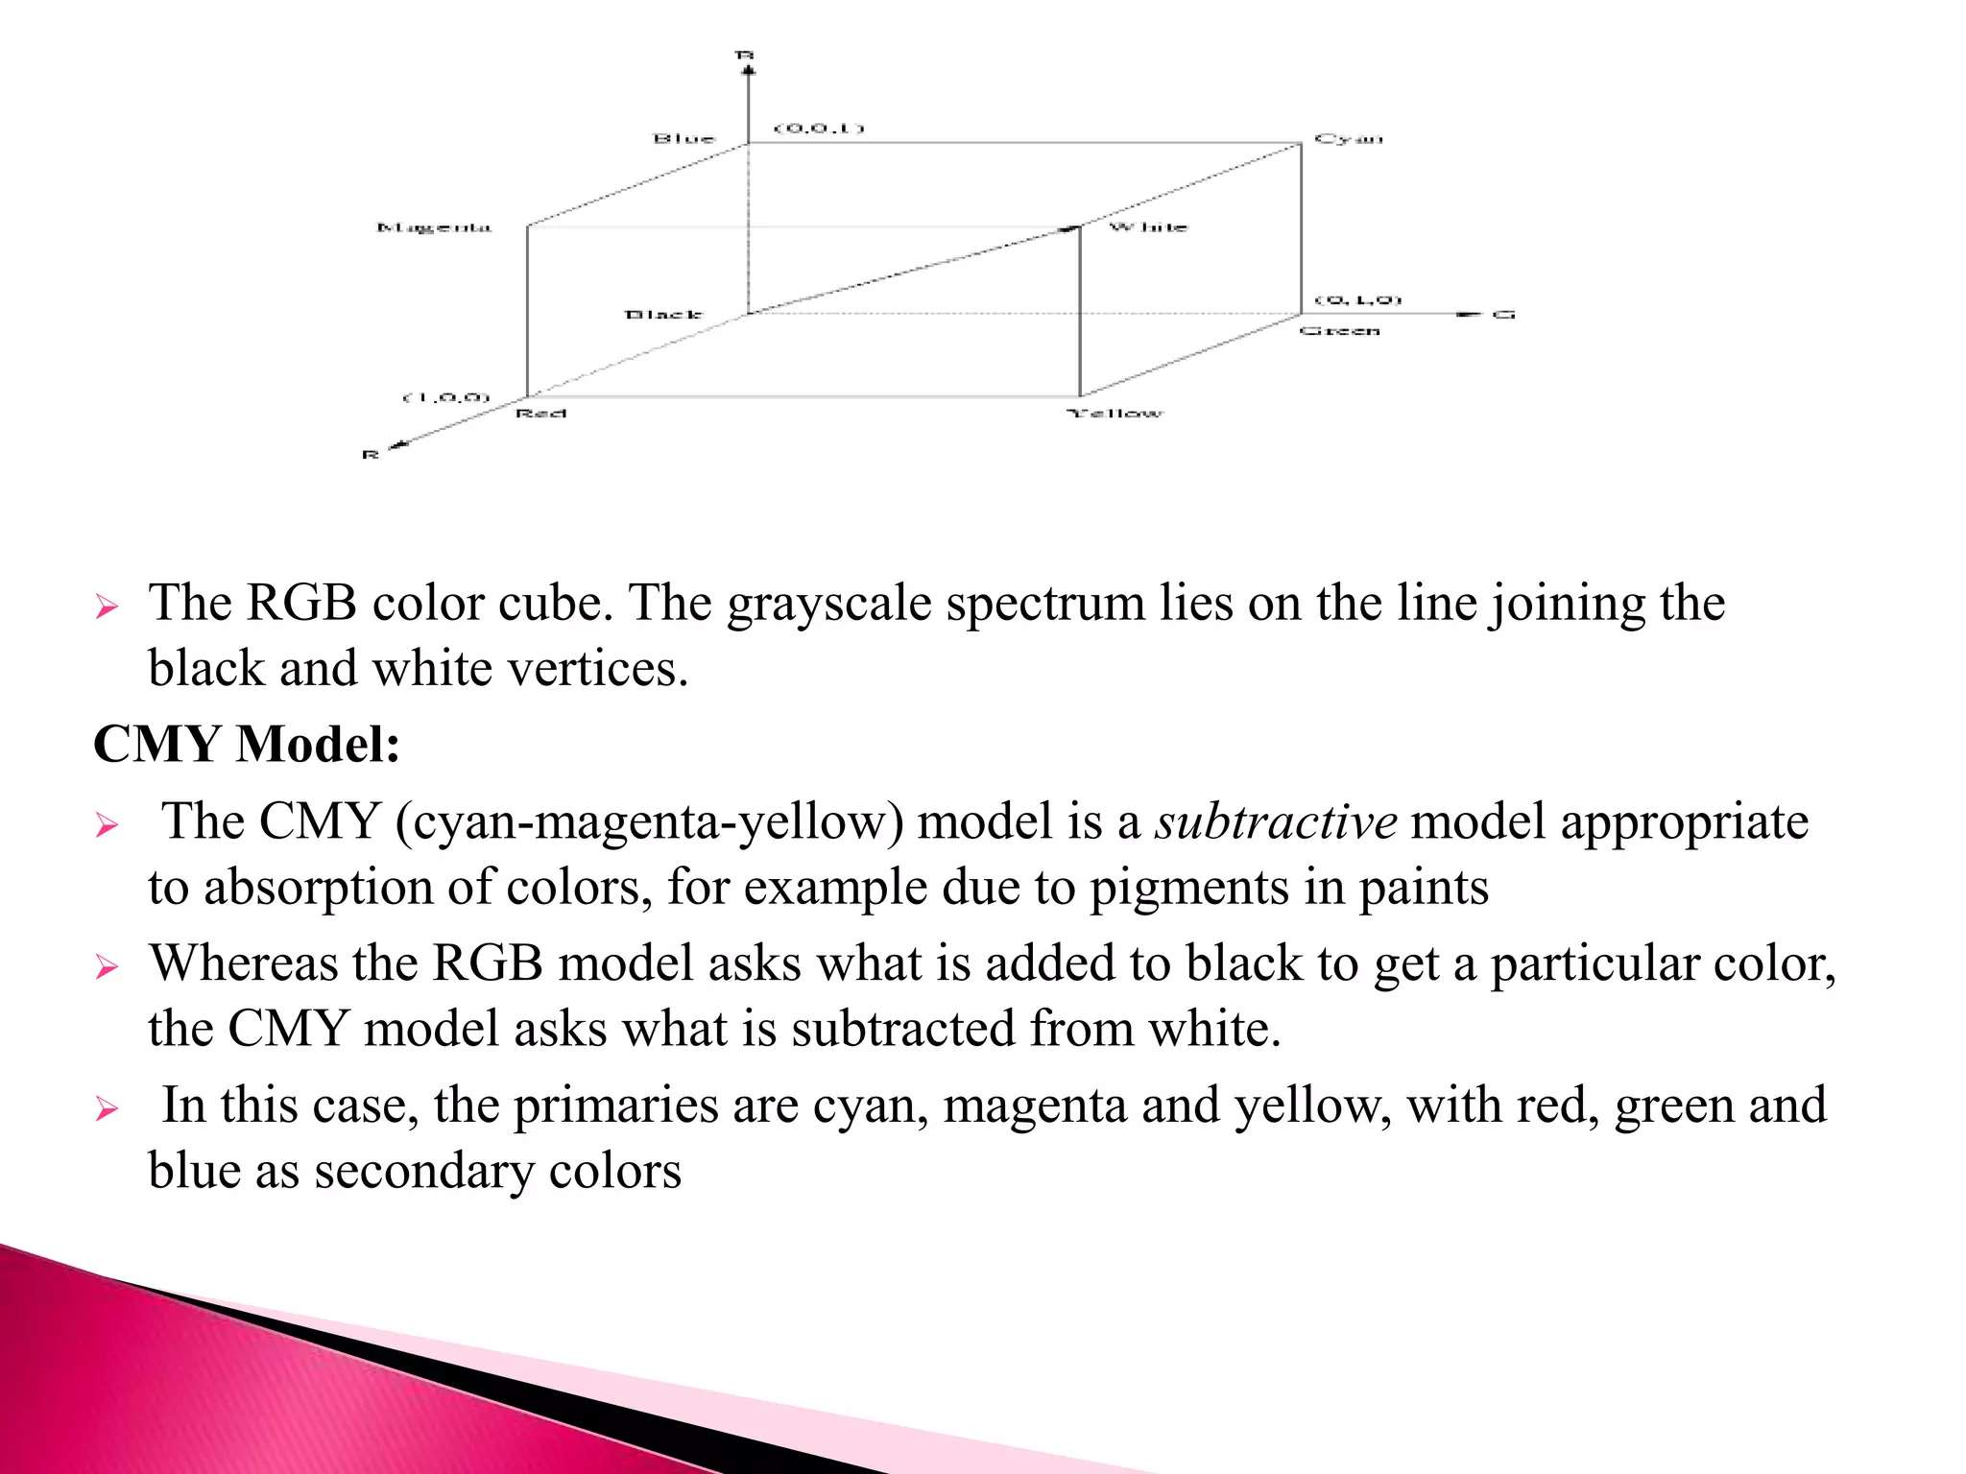

Slide 58
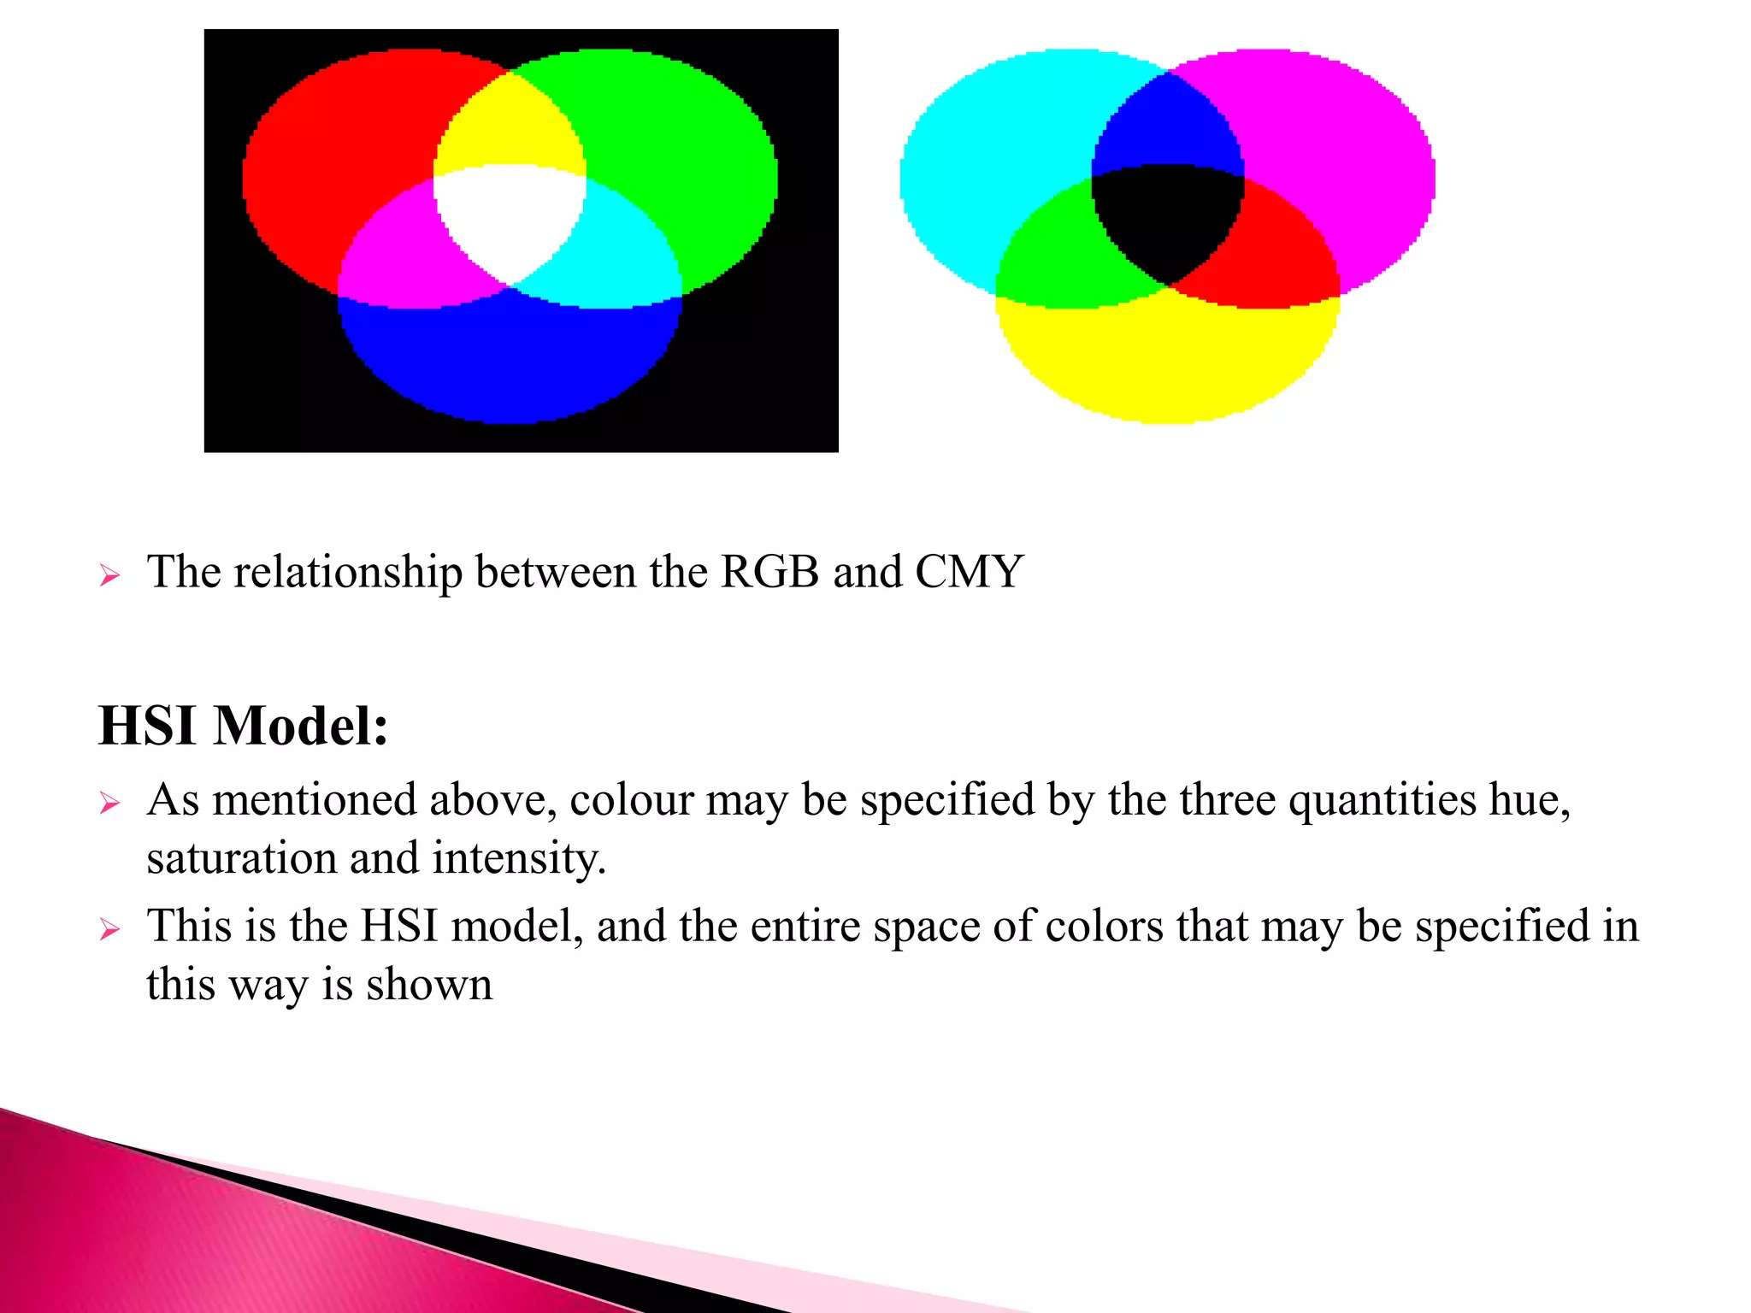

Slide 59
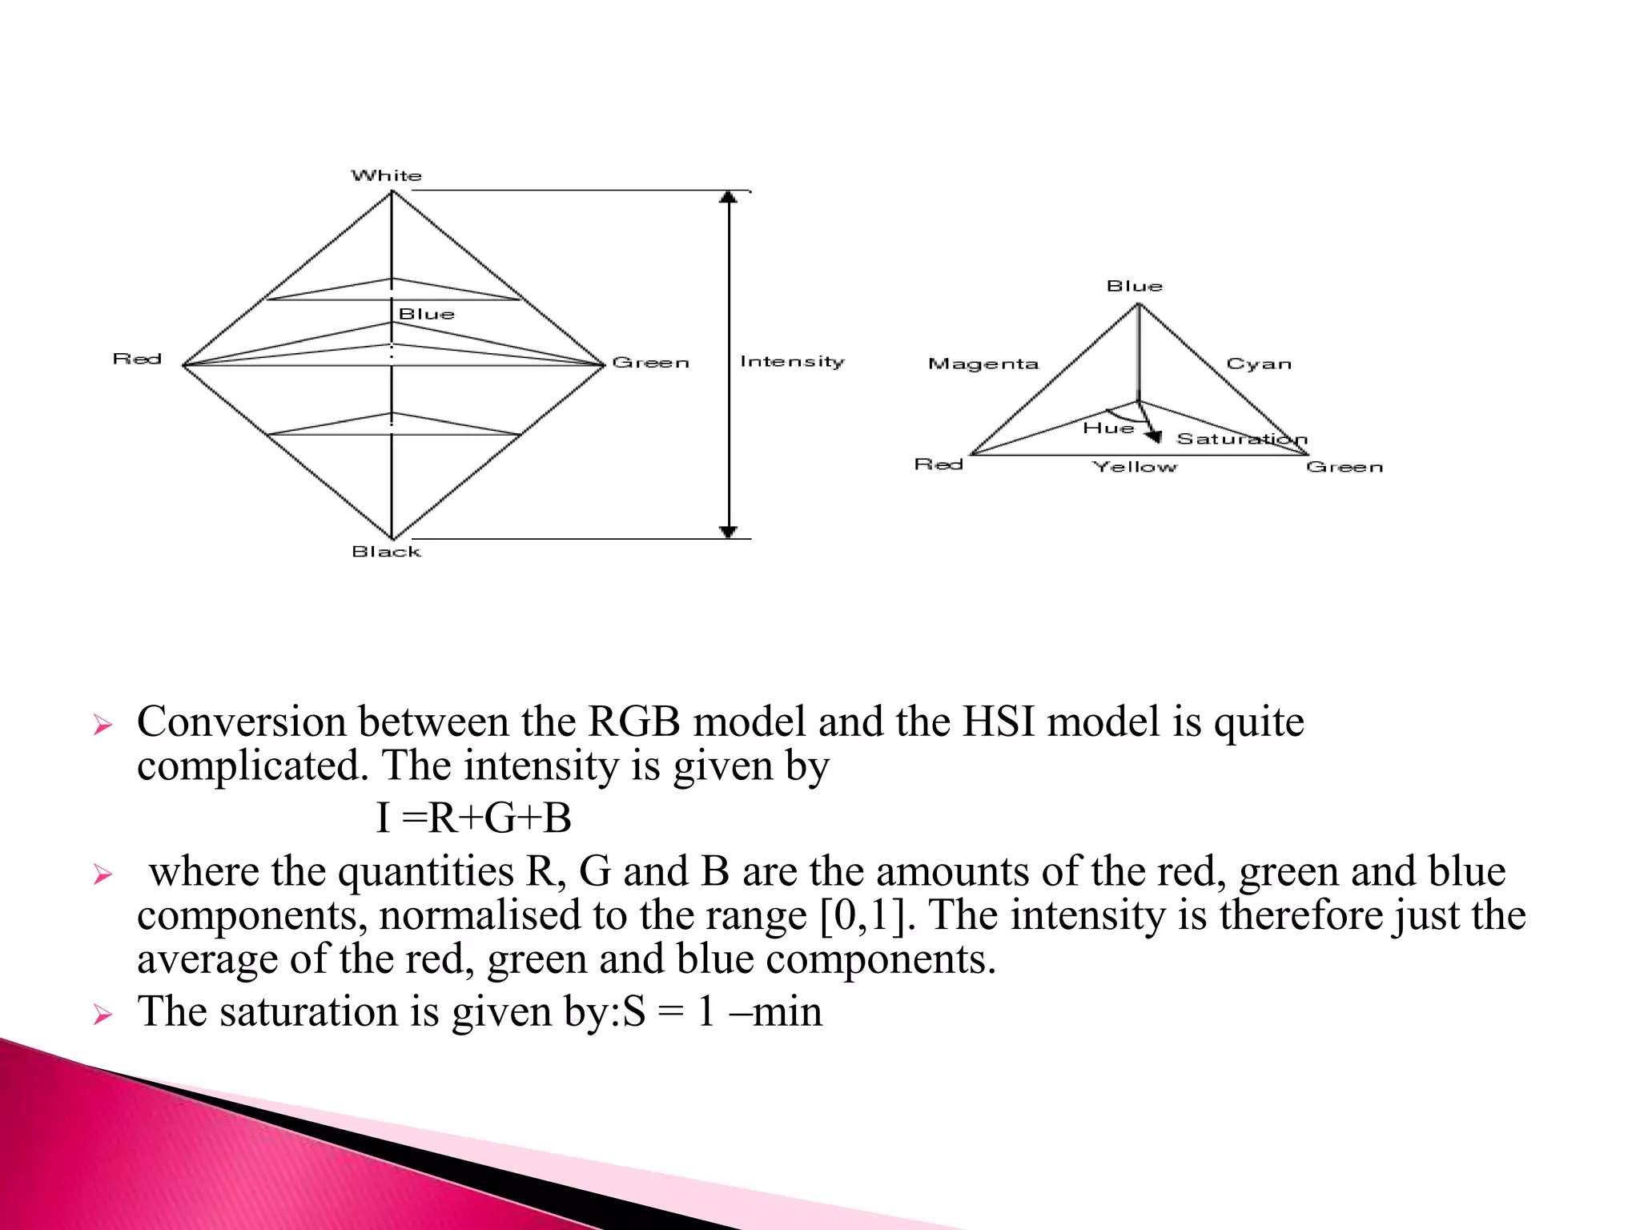

Slide 60
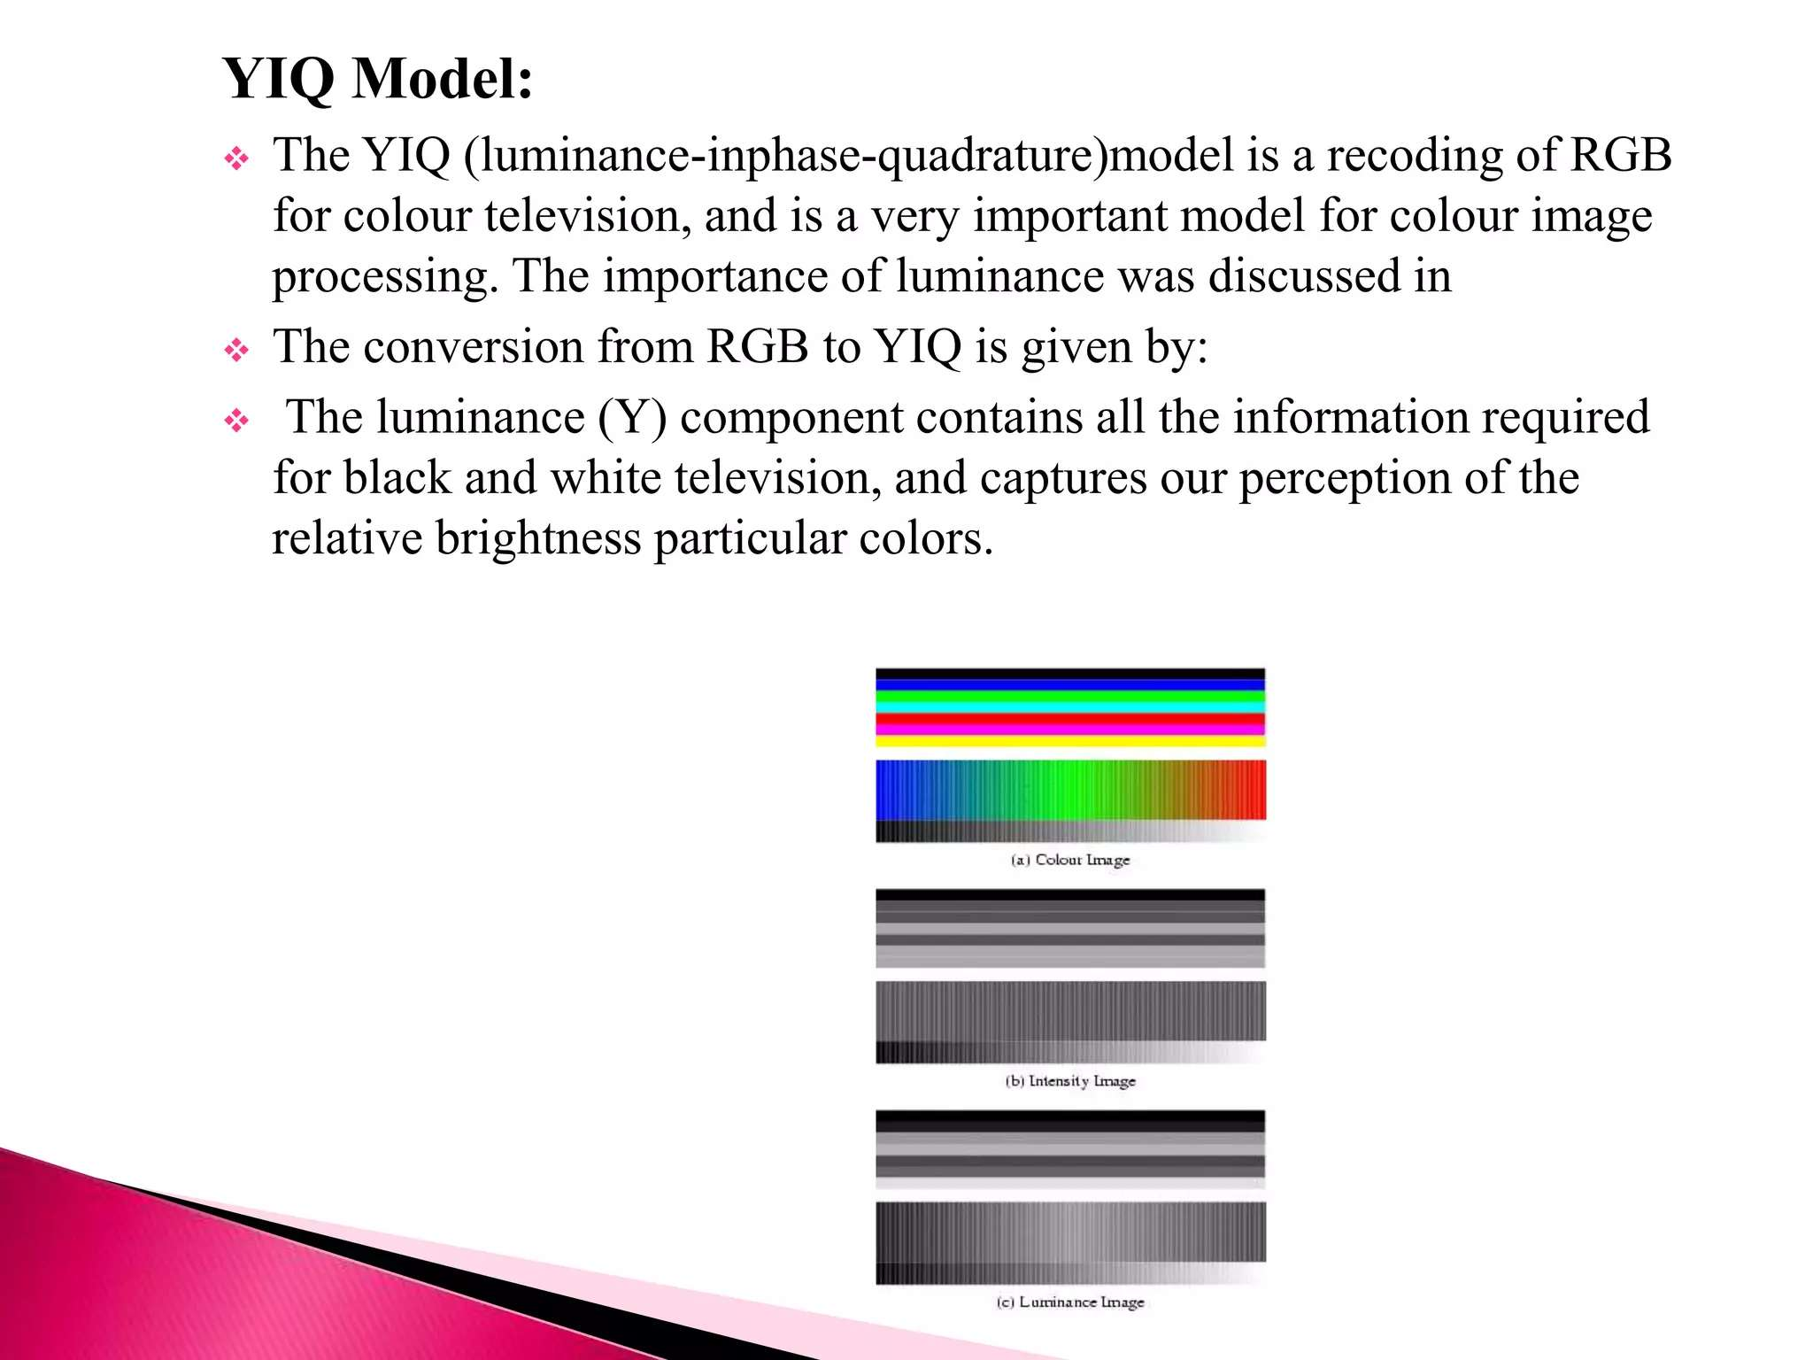

Slide 61
What is Hue?
The hue of a color is a component of its chromaticity. Red, green, and blue are the three main colors of light. It is why televisions, computers, and other electronic color visual displays use a trio of red, green, and blue phosphors to generate all electrically conveyed colors.
Hue is a single value that describes the color of something and is typically measured in degrees.
It has the colors red, orange, yellow, green, blue, purple, and magenta all the way back to red.
Although, magenta and pink colors are not light frequencies, and a rainbow may prove it.
It begins with red and progresses to different colors, but it doesn't contain magenta and pink because they are not genuine frequencies humans can see.

Slide 62
What is Saturation?
Saturation: The intensity of a color. As saturation increases, colors appear sharper or purer. As saturation decreases, colors appear more washed-out or faded
Saturation is defined by the purity of the color and its distance from the grey color. If a color has much more greyness, it has a lower saturation level. Moreover, saturation could be viewed as the hue's dominance in the color.
The outermost edge of the hue wheel includes the pure hue; as you move inside the wheel to the centre, which contains grey, the hue steadily drops, and the saturation likewise falls.
It relates to a physical property known as the excitation property, which measures the percentage of brightness mixed with the dominant or pure color.

Slide 63
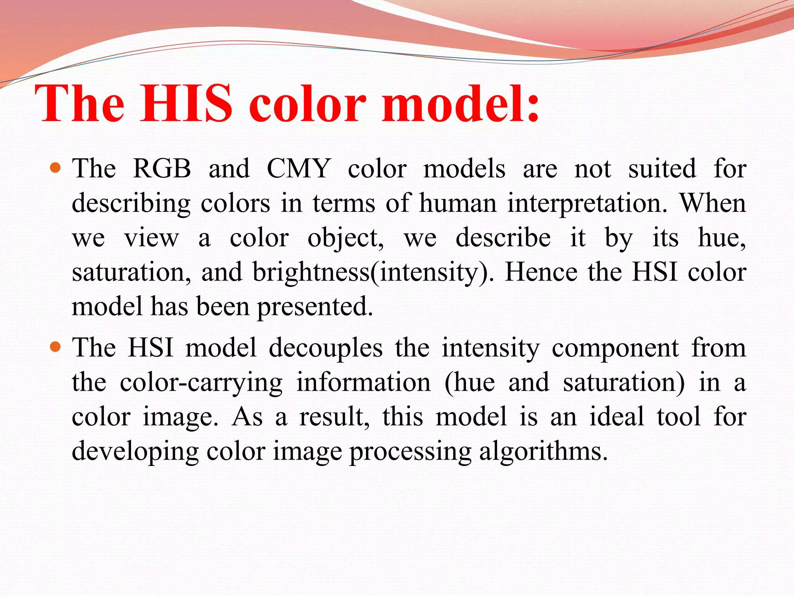

Slide 64
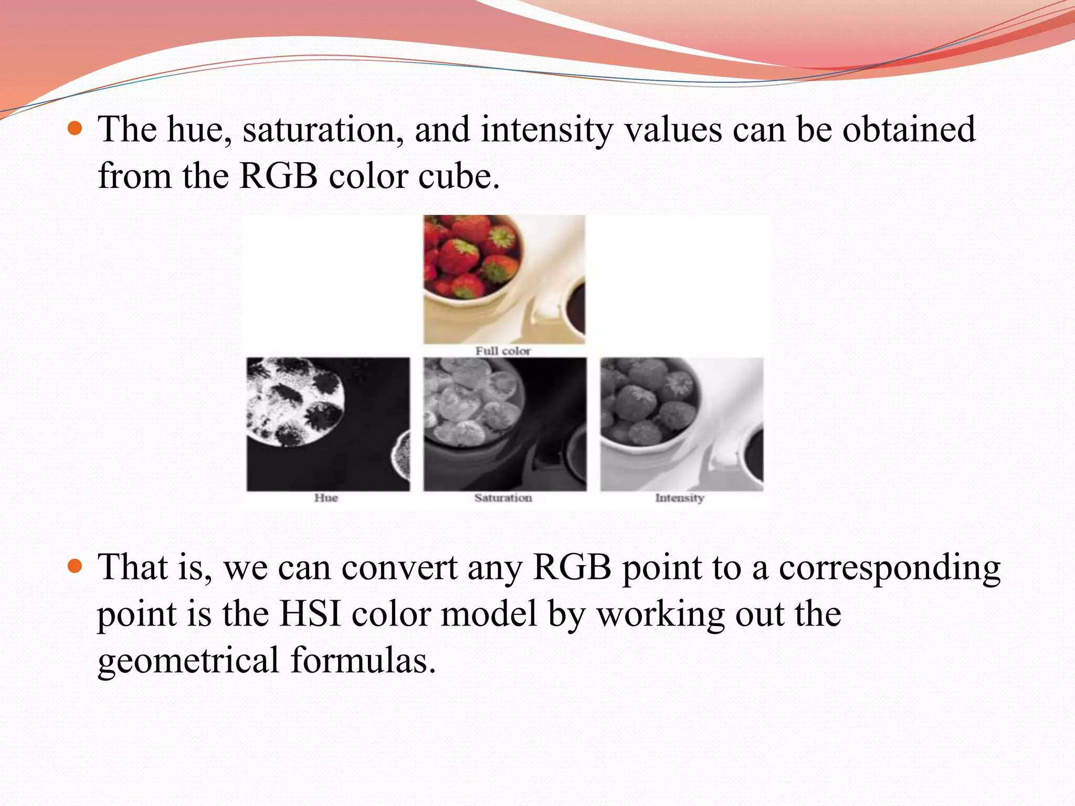

Slide 65
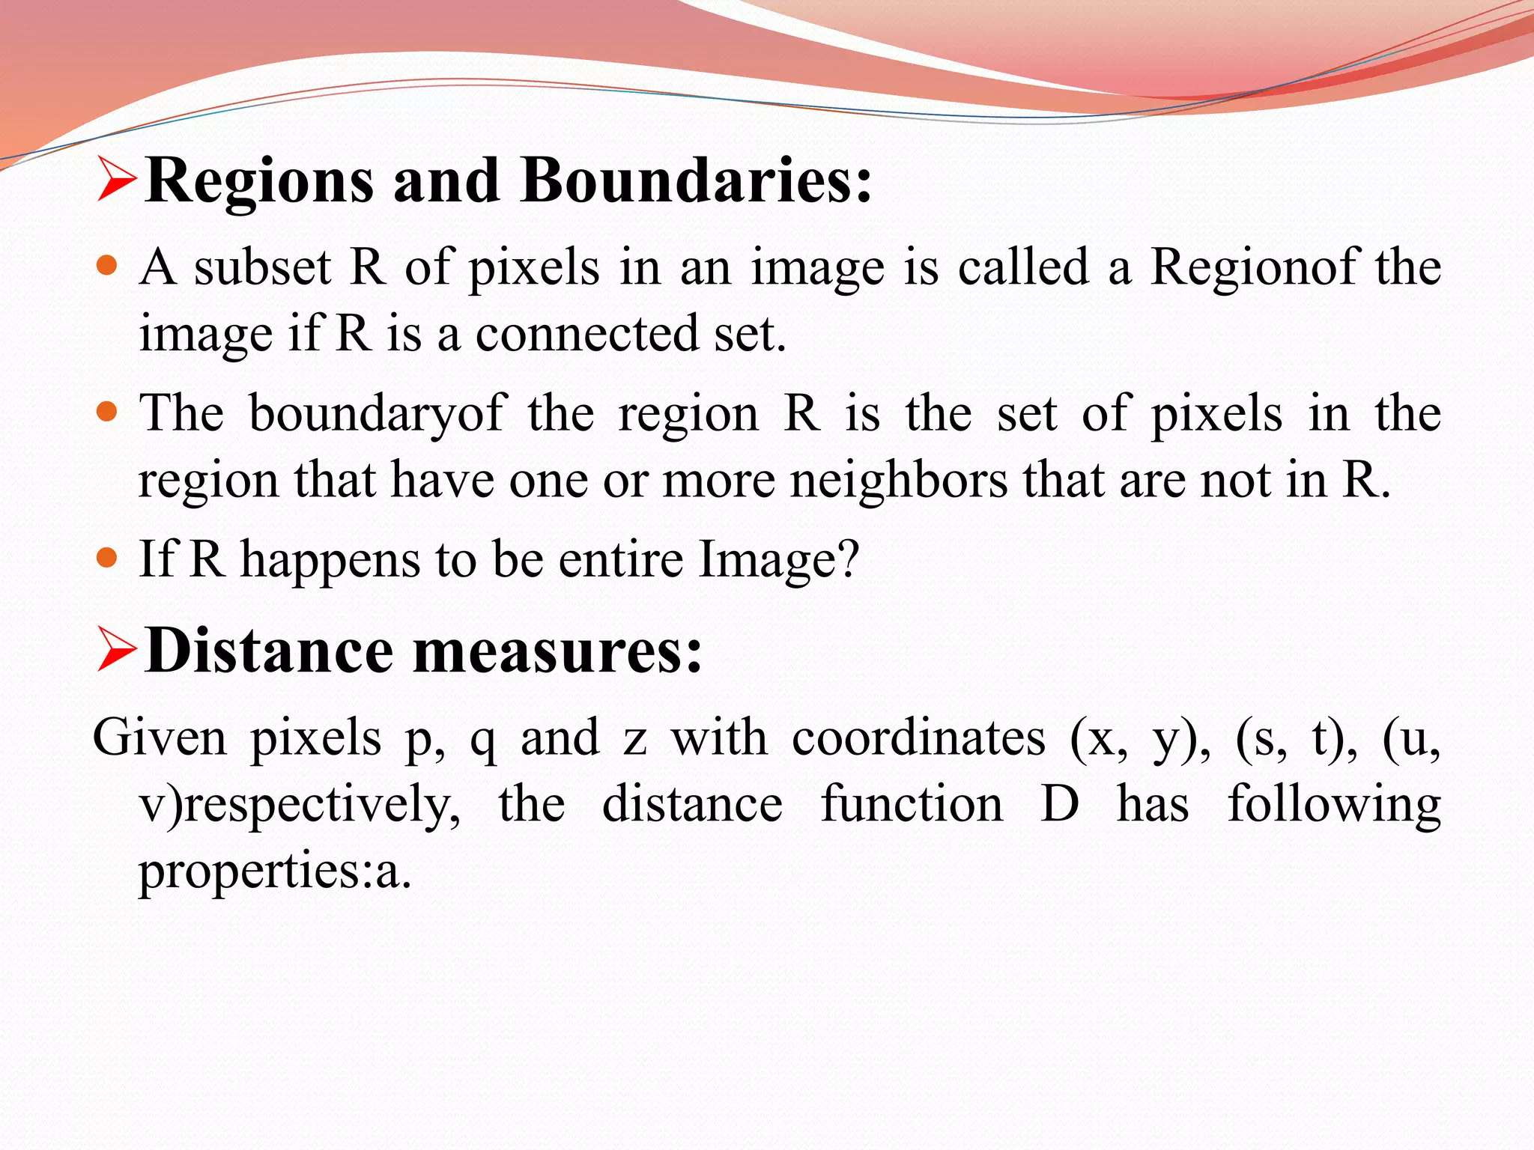

Slide 66
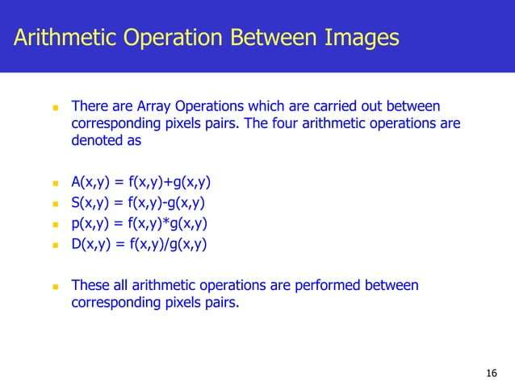

Slide 67
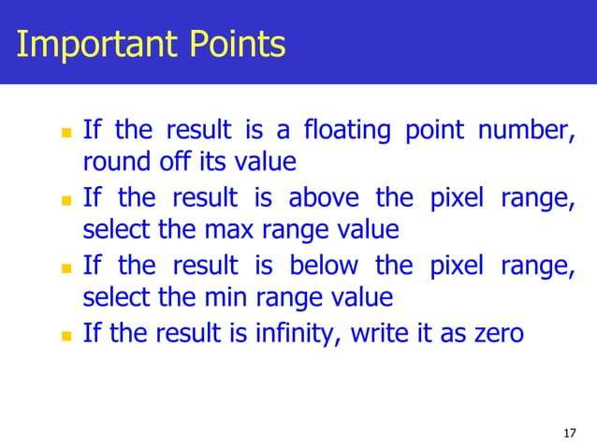

Slide 68
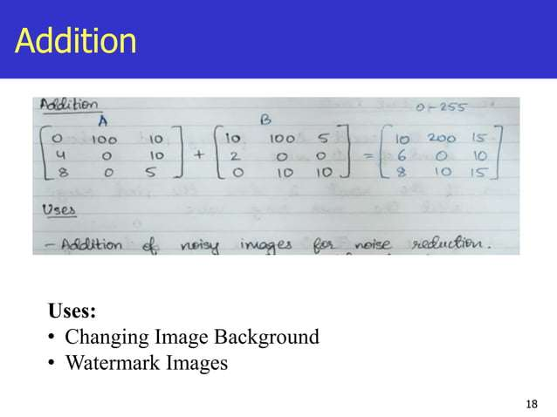

Slide 69
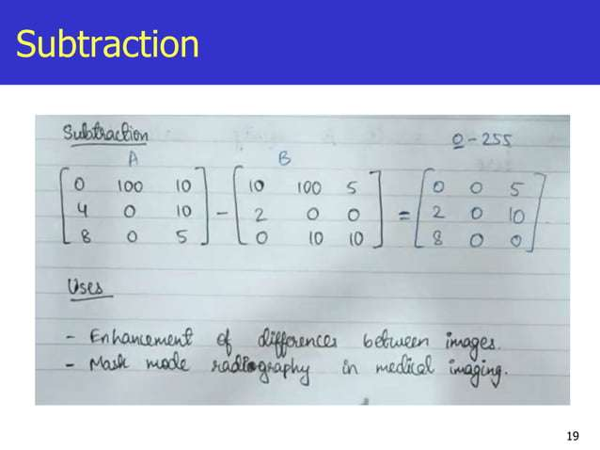

Slide 70
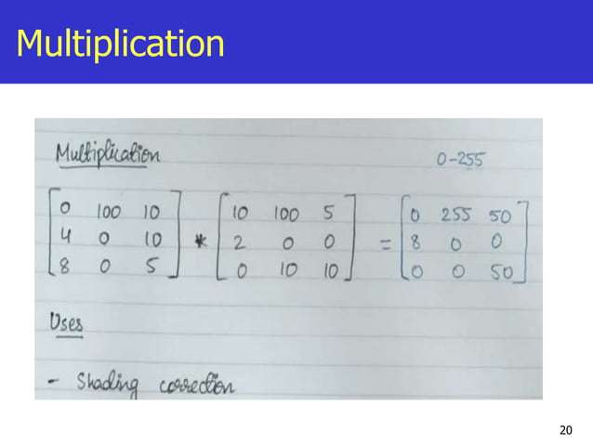

Slide 71


